Slide 1


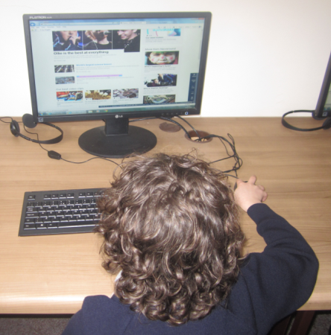




Internet Safety

Slide 2


This session...
Top Tips – the 4 C’s
Parental Controls
SMART rules
Useful websites
Questions

Slide 3


Slide 4


Our role...
Children need to be taught to use technology safely and respectfully, keep their personal information private and know where to go for help and support when they have concerns about material on the internet.

Slide 5

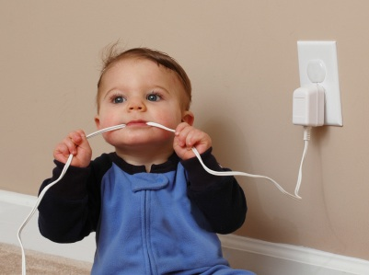
How do we keep
our children safe?

Slide 6

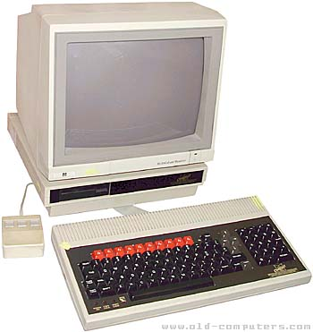
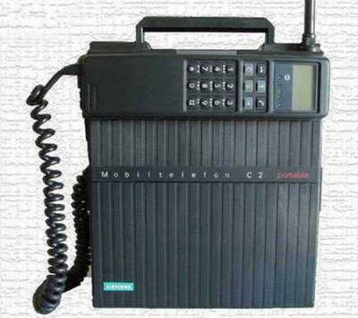
How the world has changed...
41% of young people aged between 5-15 have a games console in their room (Ofcom)
    Ofcom is the communications regulator in the UK
6/10 children have access to the Internet...

Slide 7

How do we use the Internet?
https://youtu.be/aDycZH0CA4I

Slide 8

















How well do you know... your app logo?

Slide 9






Slide 10







Digital footprints
Respect and manners
Who can view their content?
Keep their personal information safe
Reporting

Slide 11






Adult content
Hurtful and harmful content
Reliable information
Illegal downloading

Slide 12







Online friends
Privacy settings
Grooming
Cyberbullying
Tell someone they trust!

Slide 13






Advertising
In-app purchases
Pop ups
Spam

Slide 14




Open dialogue with your child
Sign up to the UK Safer Internet Centre newsletter at:
saferinternet.org.uk
Family agreement
Consider filtering and blocking software
Think before you/they post
Understand the laws
Privacy settings and reporting
Save the evidence and report the incident
Age ratings on apps and games
Protect their personal information

Slide 15

Parental Controls
Designed to help protect children from inappropriate online content.
Can be used to limit access to only age appropriate content, to set usage times and to monitor activity.
Four main places you can find parental controls:
Internet provider
Mobile operator
Devices
Online services: e,g, sites like BBC iPlayer and YouTube

Slide 16

Please note:
NOT 100% fool proof.
Important to educate your children about the potential risks online and establish rules
Involve yourself in their online world.

Slide 17

Have a concern?
Important to stay calm and consider the
steps below:
1: Find out more
    Websites/ leaflets
2: Talk to your child
3: Take action
4: Seek support for yourself
    NSPCC helpline on 0808 800 5000.

Slide 18

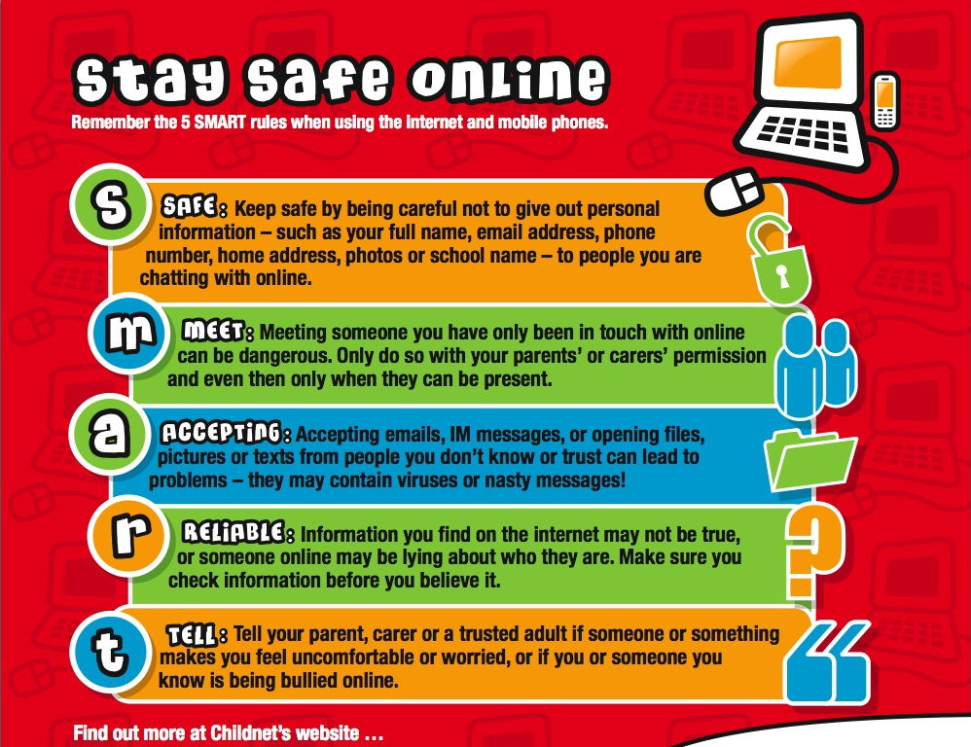
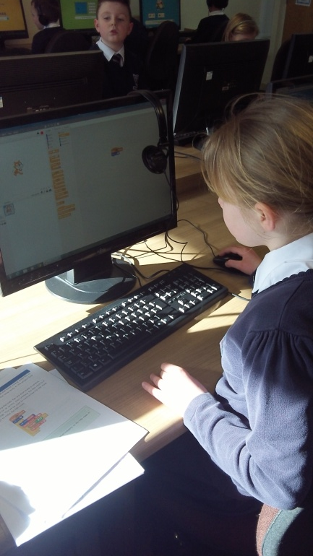
Stay SMART

Slide 19




Slide 20


Useful Websites

Slide 21


Any questions?

Slide 22


