Slide 1
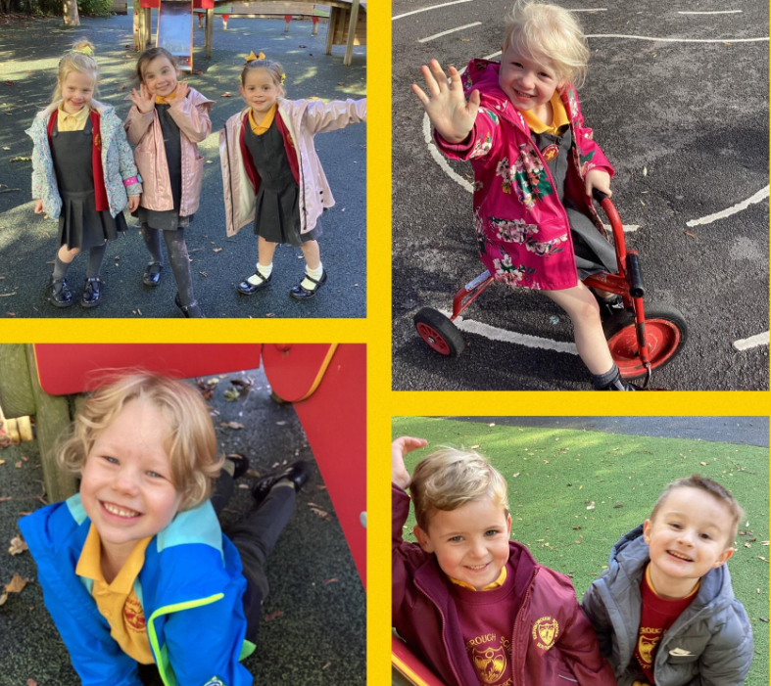

‘Learning, Caring and Achieving Together’
Farnborough Road
Infant School
This is a
happy school.
Everyone feels special, has hope
and a reason
to smile.
Ofsted 2023

Slide 2
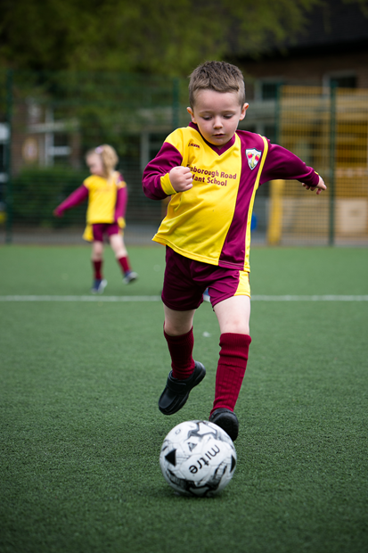
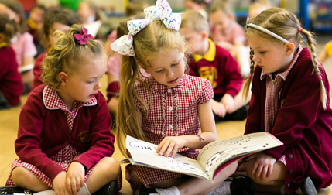
Learning, Caring and Achieving Together
At FRIS we have 5 Key Values
Respect
Compassion
Perseverance
Honesty
Love and Kindness

Slide 3

Farnborough Road Schools
We have 2 Headteachers- Miss Sephton in the Infants and Mr Antell in the Juniors
2 Governing Bodies
The 2 schools work very closely together
Both schools have 4 classes in each year group from Reception to Year 6
The Infants also has 2 Nursery classes and 2 Caterpillar classes for our 2 year olds
2 Family Wellbeing Centres

Slide 4
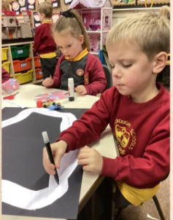
The Infant School
– Consists of Two Key Stages
The Early Years Foundation Stage and Key Stage 1
The EYFS runs from birth to the end of Reception – our Caterpillar Class , our Nursery and Reception Classes
Then KS1- Year 1 and
Year 2

Slide 5
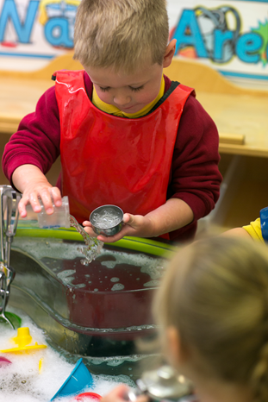
Nursery
Each class will have at least 2 key
adults.
Your child will have a named
“key person/key worker”
All adults working with your child
will get to know them very well and
develop links between home and school

Slide 6

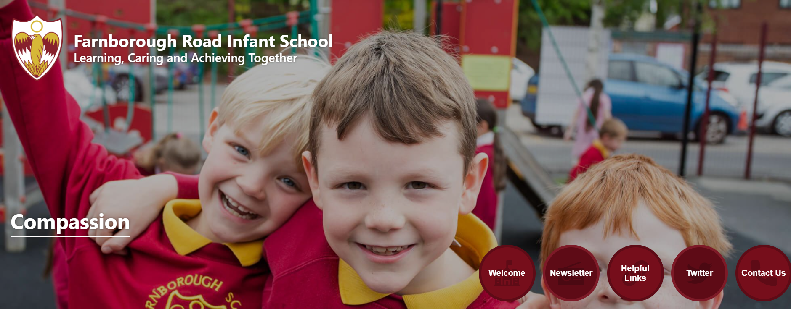


Communication with Parents
We use a variety of ways to
communicate with parents:
Our School Website www.farnboroughroadinfants.co.uk
The Parent App – details to follow
Twitter @FrisInf @Frisroom1
Class Dojo

Slide 7


Good Attendance and punctuality are key for success in school.
We monitor attendance continuously. Please aim for full attendance. 96% or above will have a very positive effect on your child anything less will have a negative effect.
Holidays in term time can not be authorised by Headteachers.
Please check the dates of the school terms carefully and arrange holidays and appointments out of school time.
Dentist /doctor appointments – only urgent appointments in school day.
Also important to be punctual as the gates will be locked at 9am so that it is safe for all the children in school to play out. You will then be required to sign in at the school office.

Slide 8

Safety and Car Parking
Farnborough Road is a permit only zone between the hours of 8am and 4pm. Please park on Liverpool road or the surrounding roads and walk in.
Guildford Road Gate will only be open in the mornings – not middle of the day.
Please do not drive down Farnborough Road.
School is supported by police but really if you care your own child’s and others safety you should not be choosing to come down.
Young children are unpredictable. There have been several near misses involving children and adults, pedestrians and bikes with cars attempting to do three point turns!
Please tell grandparents and anyone else collecting your child too.

Slide 9


Slide 10
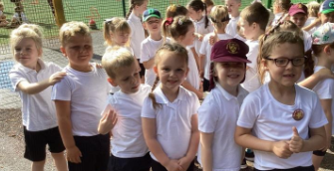
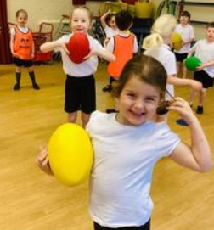
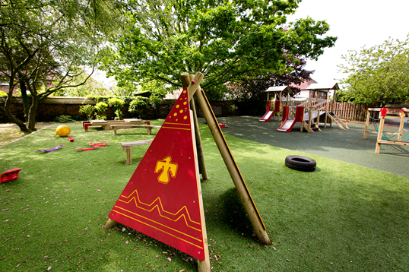
Early Years Foundation Stage
Curriculum
There are Three Prime Areas of Learning
Personal, Social and Emotional Development
Self regulation
Managing Self
Building Relationships
Communication and Language
Listening and Attention and Understanding
Speaking
Physical Development
Gross motor skills
Fine Motor Skills

Slide 11
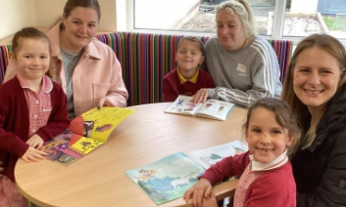
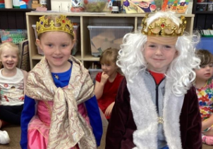
And Four Specific Areas of Learning
Literacy Comprehension
Word Reading
Writing
Mathematics
Numbers
Numerical Pattern
Understanding the World
Past and Present
People, Culture and communities
The Natural world
Expressive Arts and Design
Creating with materials
Being imaginative and expressive

Slide 12

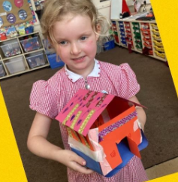
Transition activities at Farnborough Road Infant School
We have lots of opportunities for the children to meet the adults and explore the Nursery environments.
Home visits
Family Wellbeing Centre activities
Stay and play sessions
Staggered start dates
Notes:
‹#›

Slide 13


Readiness for Nursery
Ready for the next step in September
Remember to practice those Independent skills and
Health and Self Care Skills

Slide 14

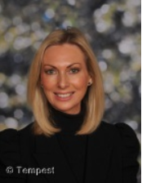
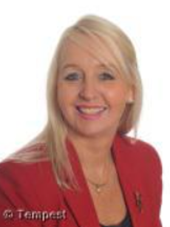
We look forward to seeing you in September ……..
Miss Sephton
Headteacher
Mrs Price
Deputy Head / Early Years Lead

Slide 15


