Slide 1
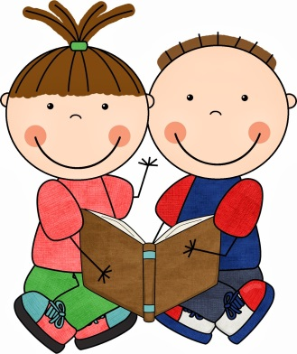


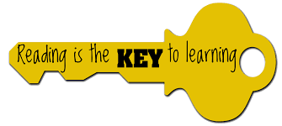




Slide 2
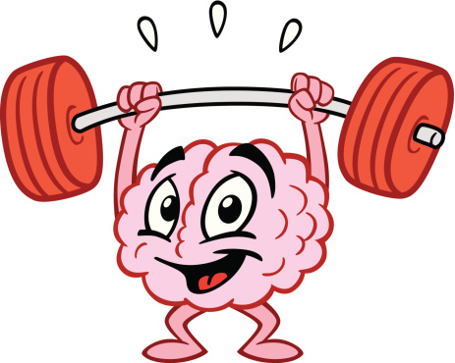

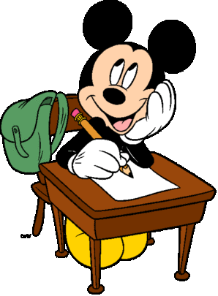
Why you should read everyday…
It exercises your brain
It entertains you
It can help you to relax
It teaches you amazing new things
It teaches you new words
It improves your memory
It helps you to focus
It makes you a better writer

Slide 3
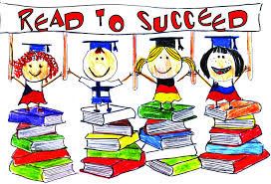
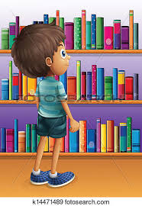
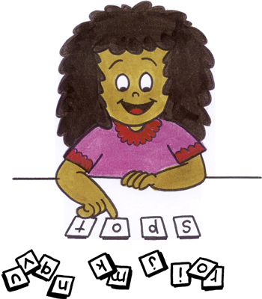
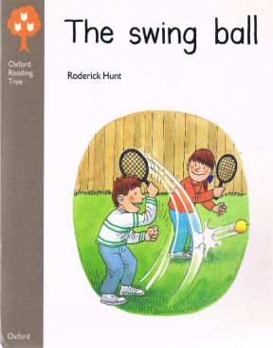


What is Read to Succeed?
It is a FRIS approach to get all of our children reading a bit each day.
everyday

Slide 4
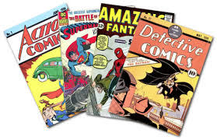
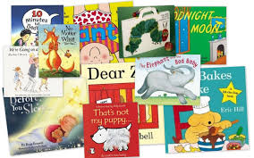


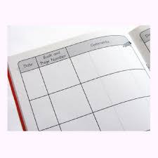
Your reading diary should come into school everyday so that Teachers can also write in it.
Each week your teacher will look at your reading diary to see if you are reading daily
At the end of the half term, each teacher will take your reading diary and look for signatures and comments. They will also be thinking about who is trying hard and who is making progress.
They will then choose 4 children from their class for a special reading treat…

Slide 5
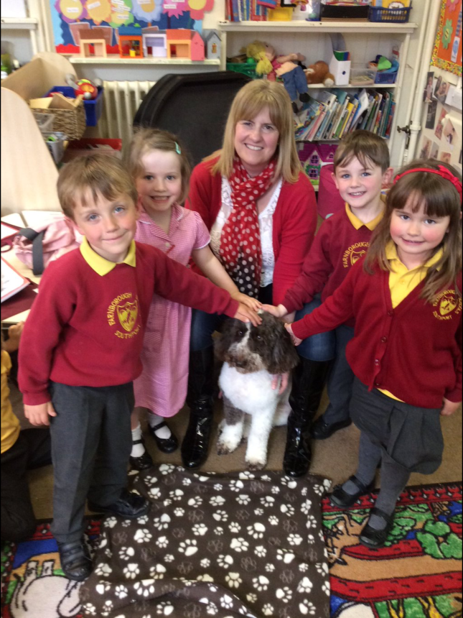
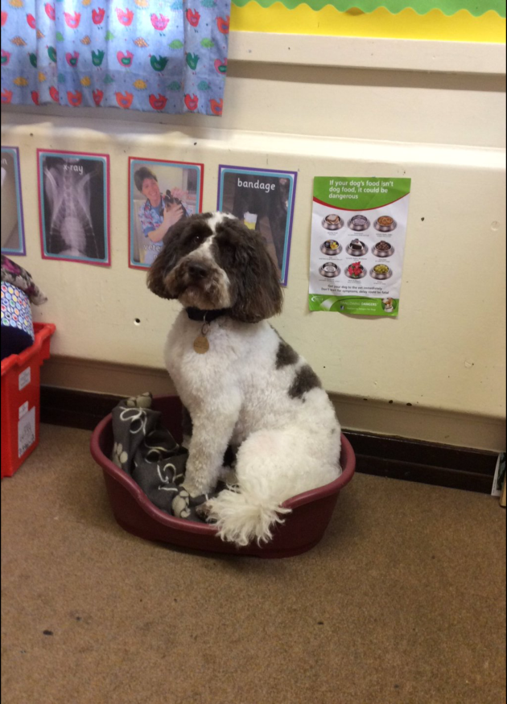
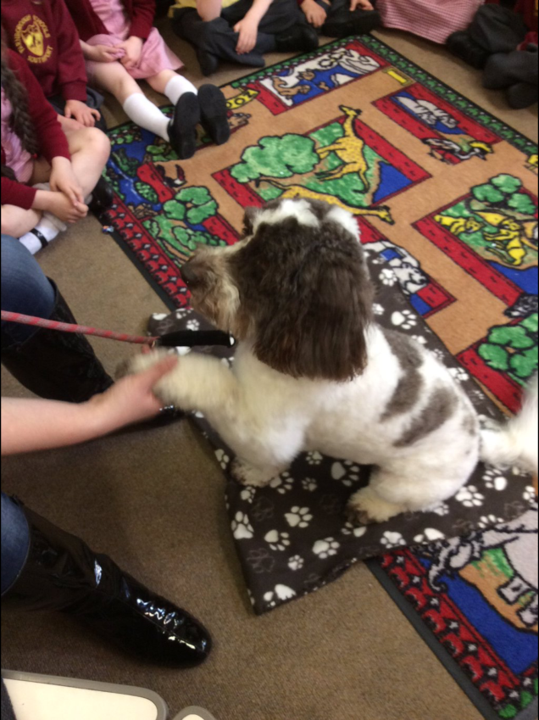
Children will get to spend time in our library, reading to
Archie The Reading Dog.

Slide 6

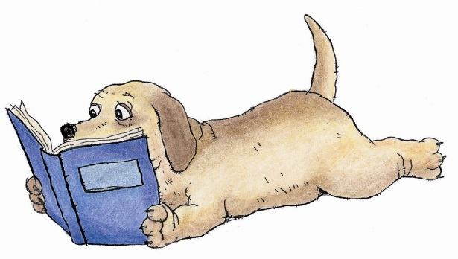
Our FRIS Reading Dogs
The class Reading Dog will go home with someone everyday for an extra read.
Read with the dog after school and return it the day after so someone can take it home.
If you like your can post a picture of you reading with your class dog on Twitter.

Slide 7
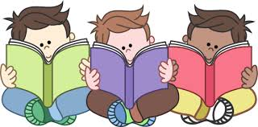
Read in school too!
We have lots of books in school – if your Teacher spots you choosing to read a book in class, they will write this in your reading diary too.
The more you read, the more chance you will have of reading with Archie!

Slide 8


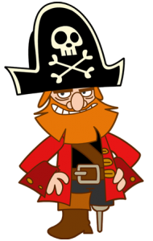



Read to Me by Jane Yolen
Read to me riddles and read to me rhymes
Read to me stories of magical times
Read to me tales about castles and kings
Read to me stories of fabulous things
Read to me pirates and read to me knights
Read to me dragons and dragon-book fights
Read to me spaceships and cowboys and then
When you are finished - please read them again.

