Slide 1
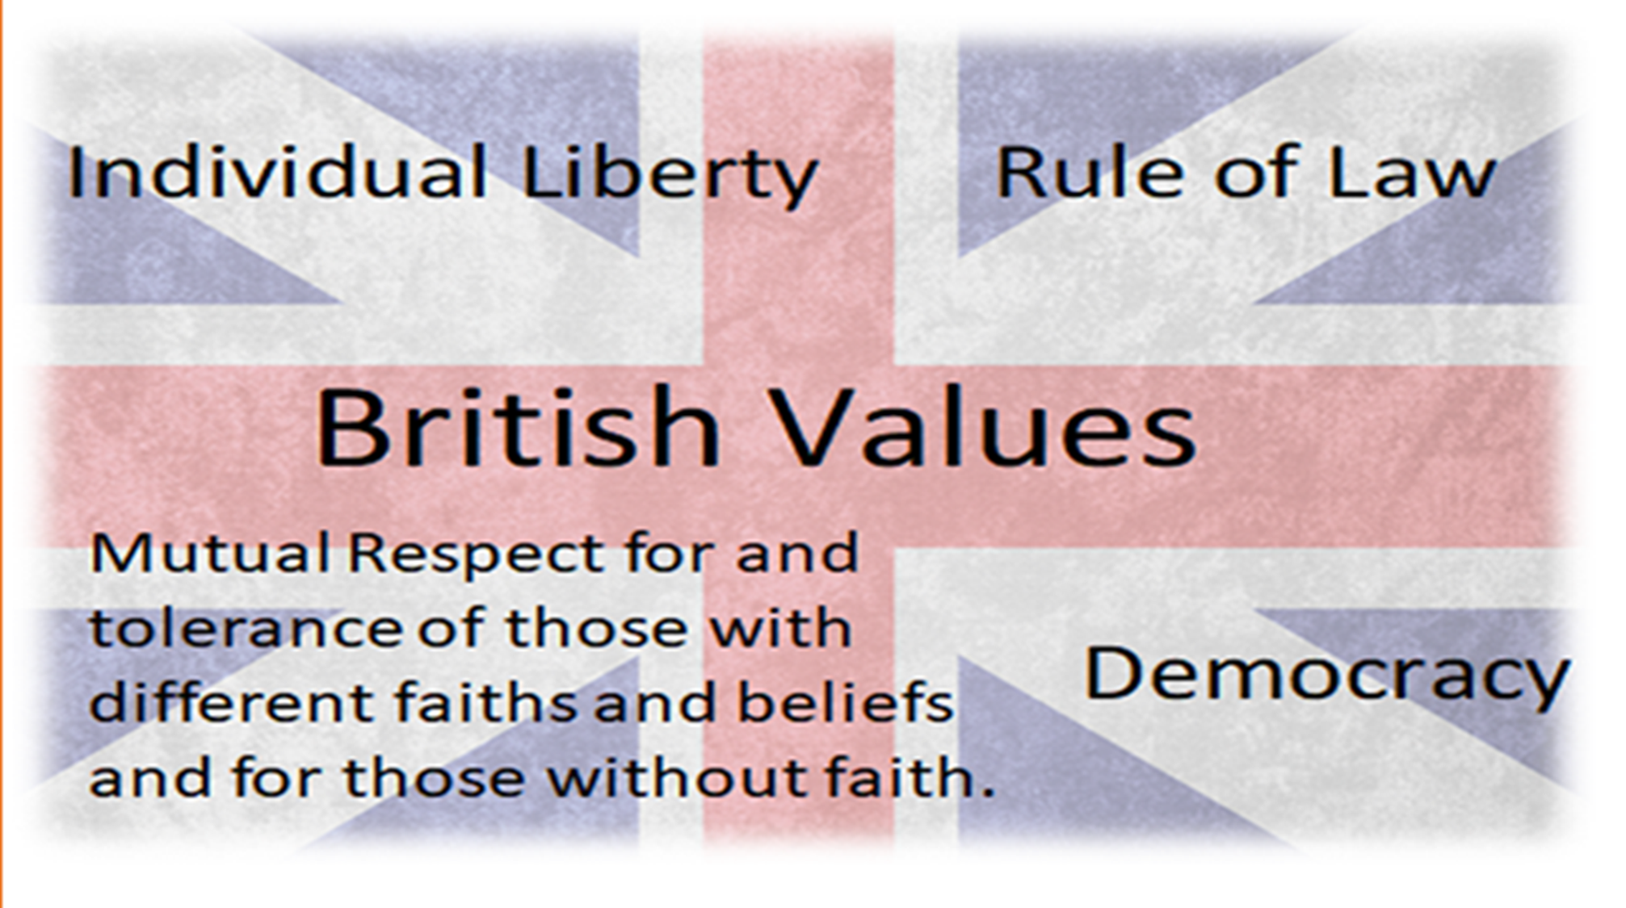

Slide 2
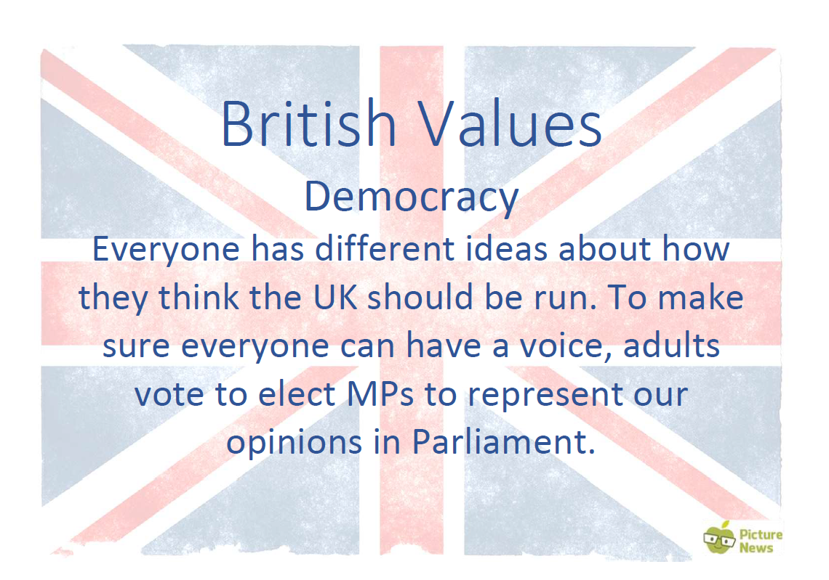

Slide 3
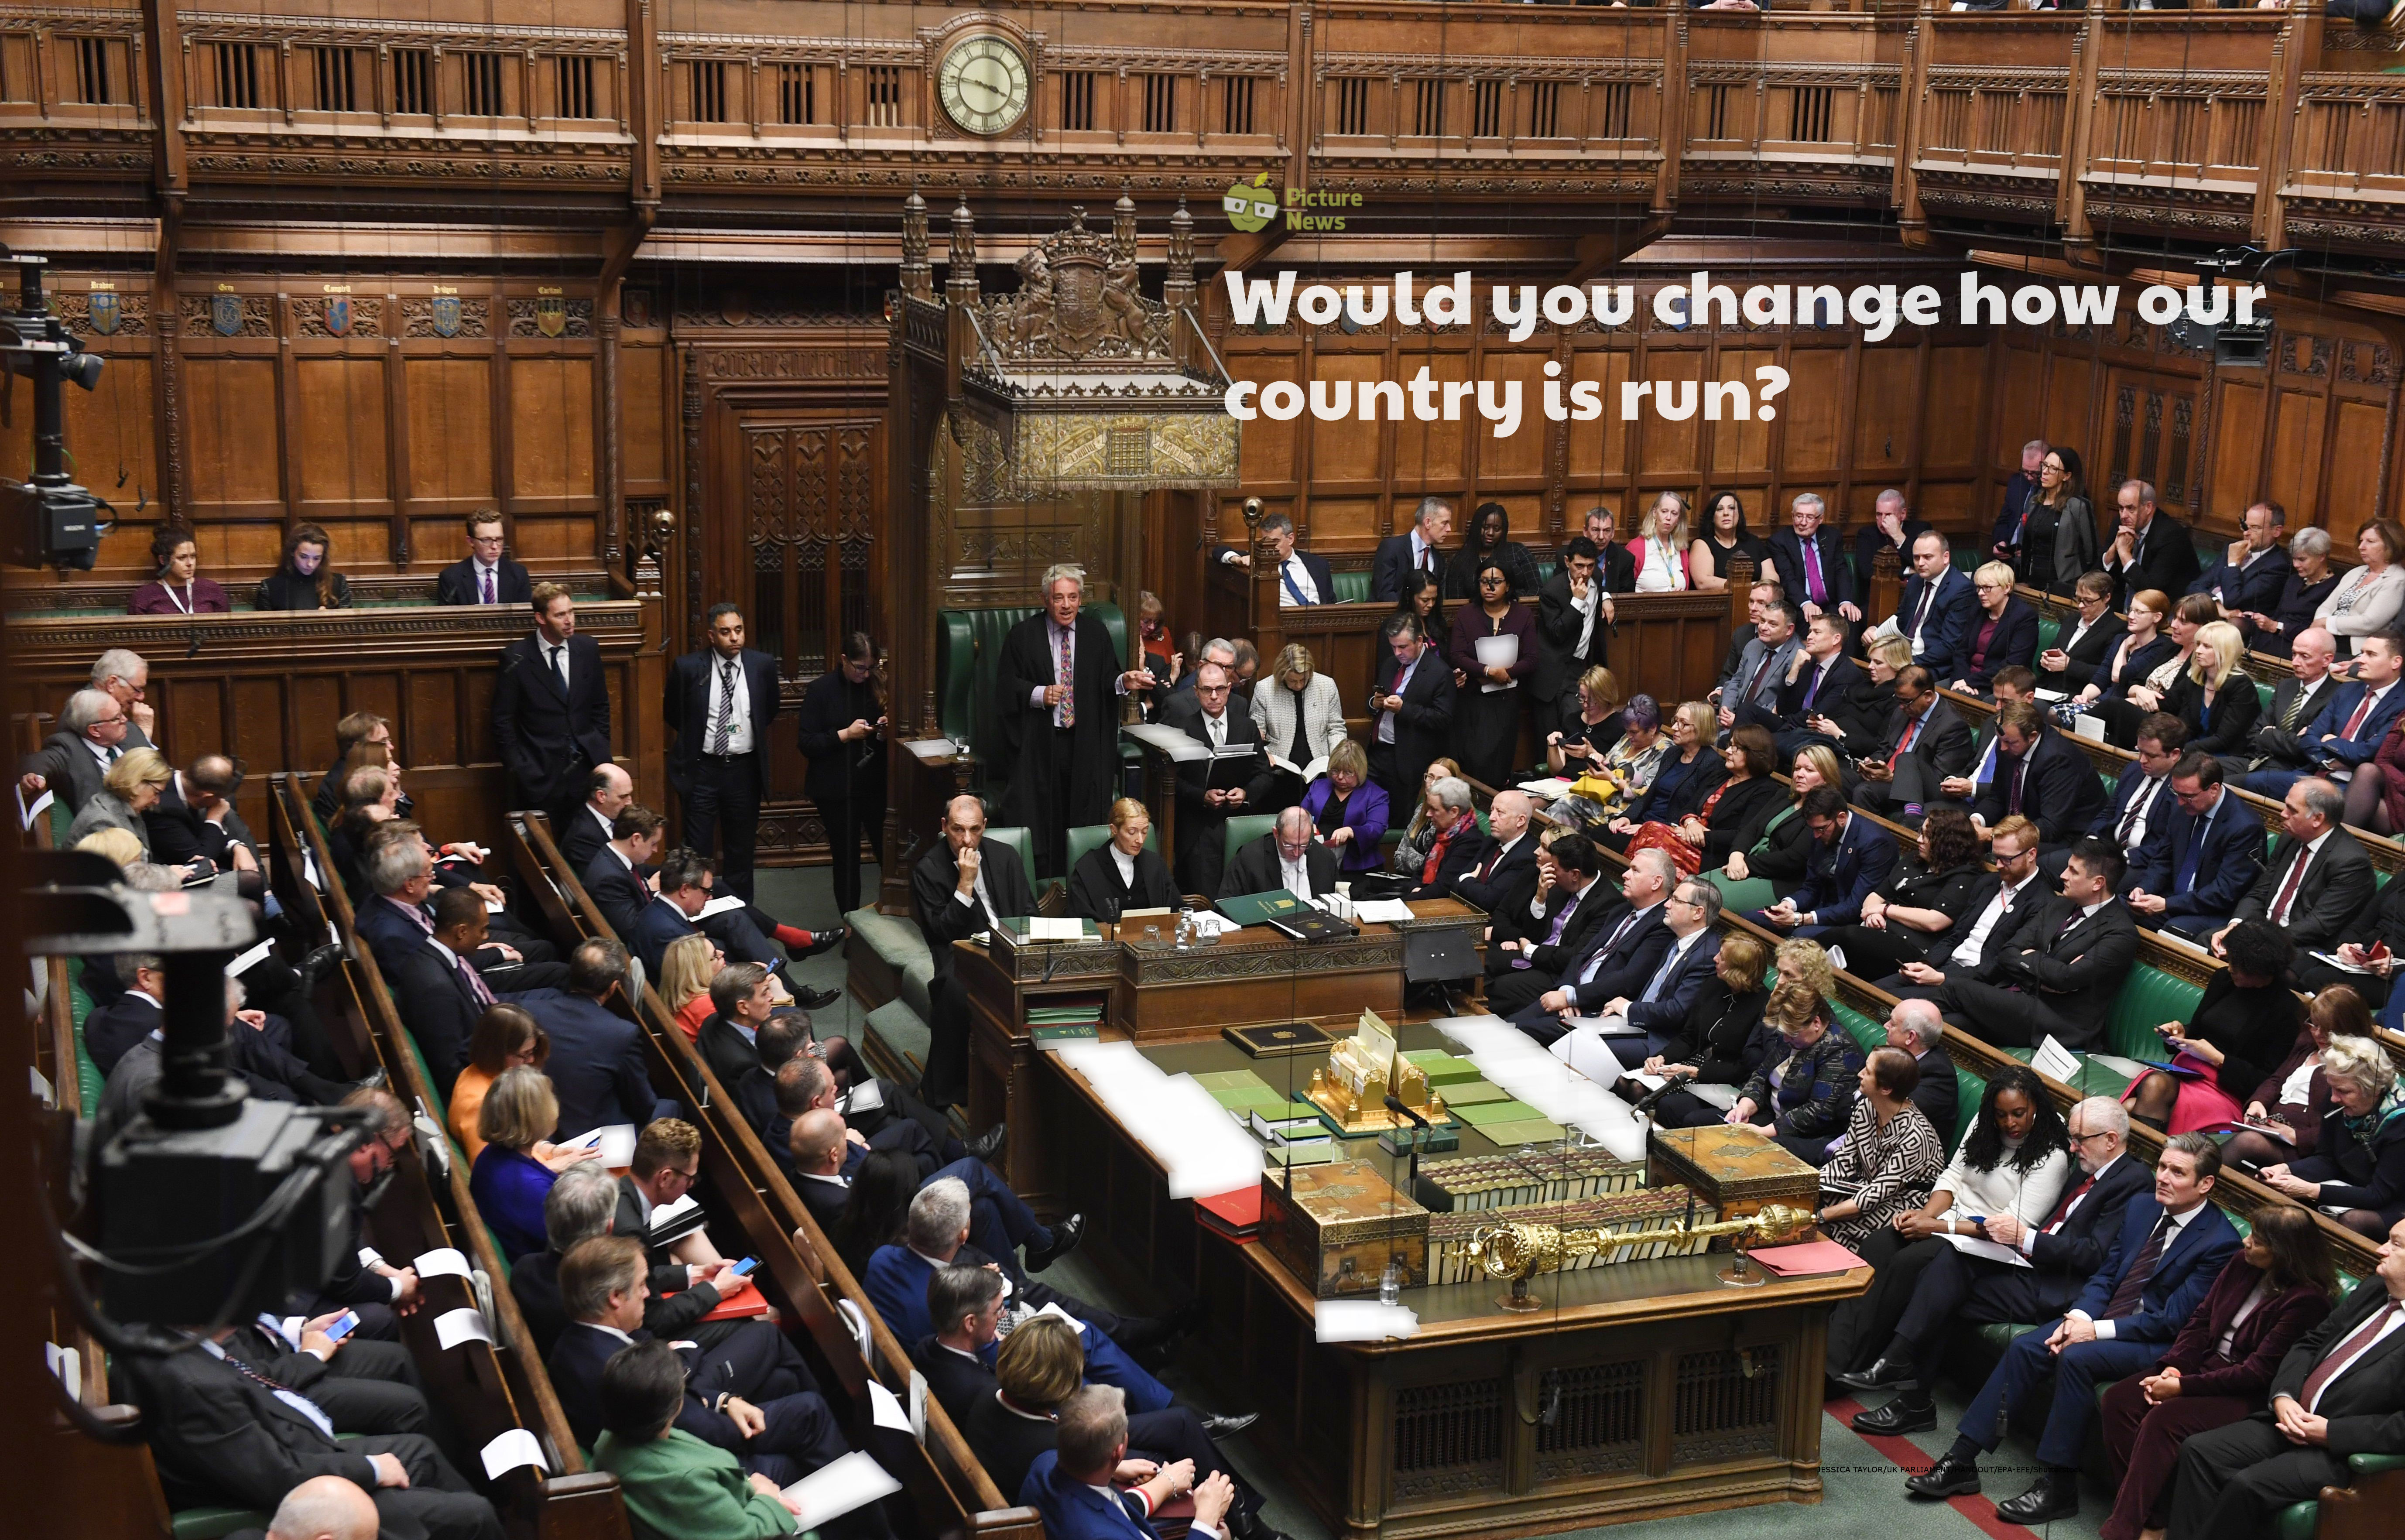

Slide 4
In the news this week…
The 2nd-8th November is UK Parliament week, a week to learn all about how Parliament works. In recent months, MPs who work in the House of Commons (part of Parliament) have received disapproval from some people who believe that the 650 MPs who make many of the key decisions in the running of the UK have not been working effectively together.
How would you convince someone to vote for you?

Slide 5
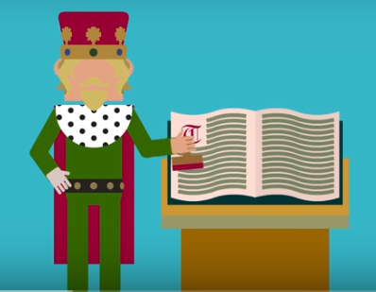
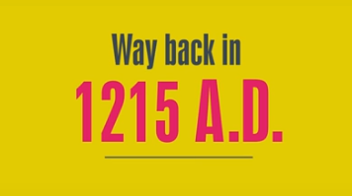
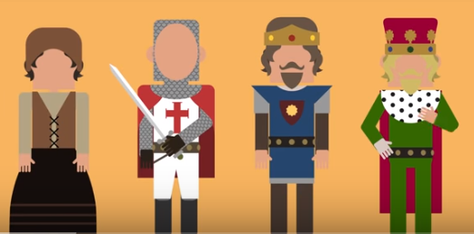
History of Parliament
King John signed the Magna Carta a list of 63 rules set by Barons (Land owners)
This was the first time even the King could not break the law of the land.

Slide 6

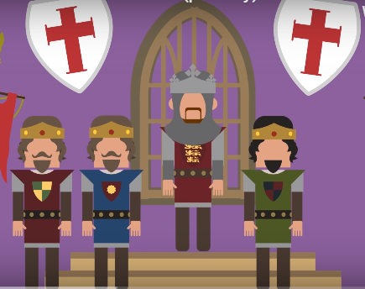

50 Years Later
Power to make decisions was passing from the Monarch (the King / Queen ) to a Parliament
Simon De Monford invited representatives from the towns and villages to his 1265 Parliament

Slide 7
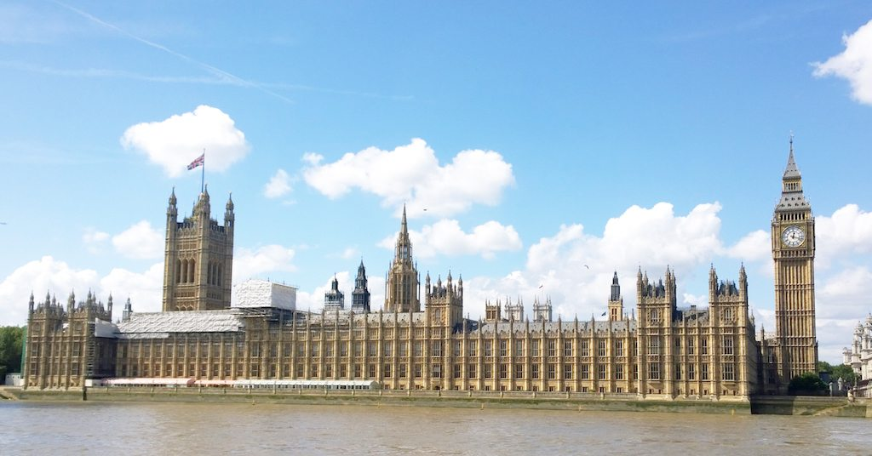
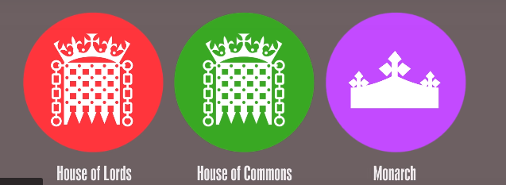
So what is Parliament now ?
Houses of Parliament

Slide 8
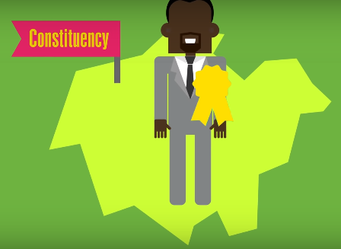
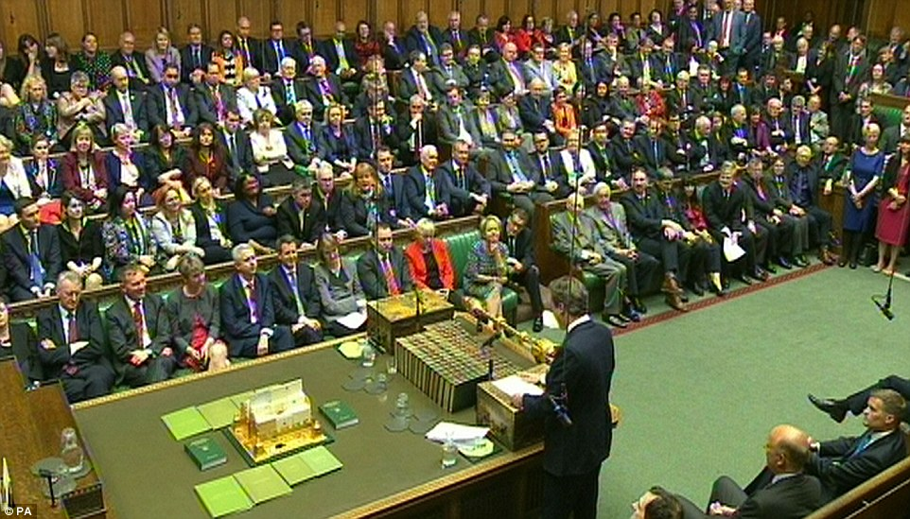
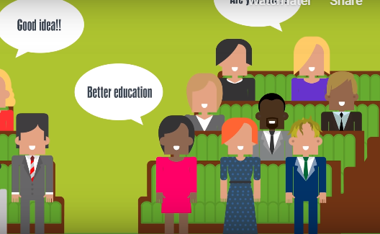
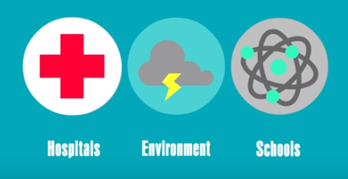
650 representatives are voted from areas (constituencies) around the country to sit on the green benches of the House of Commons and become Members of Parliament.
They discuss / debate what should be the laws of our country.

Slide 9
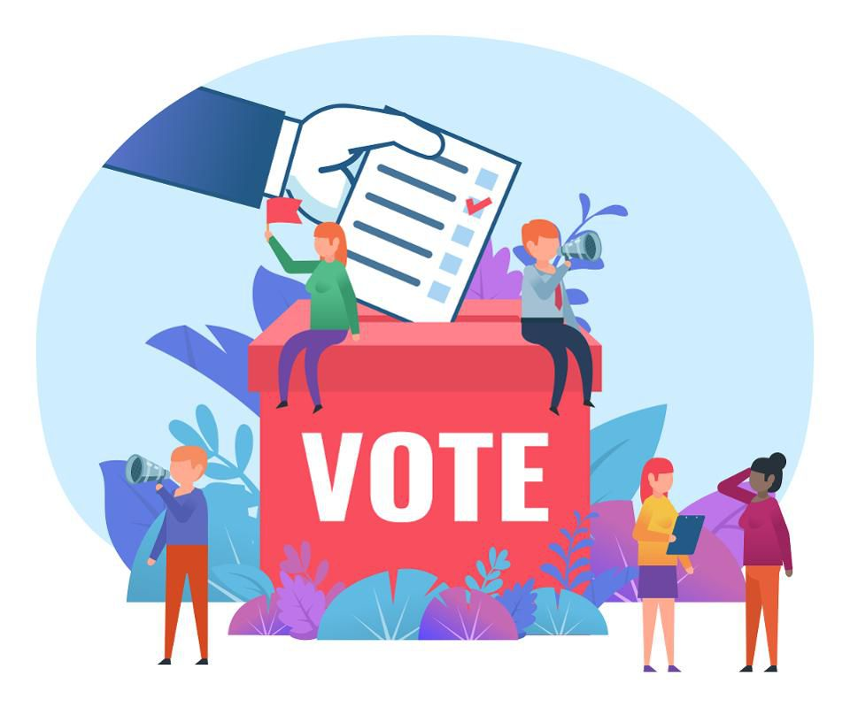
This is what we call a Democracy – as everyone over 18 has the right to vote for their local Member of Parliament (MP)

Slide 10
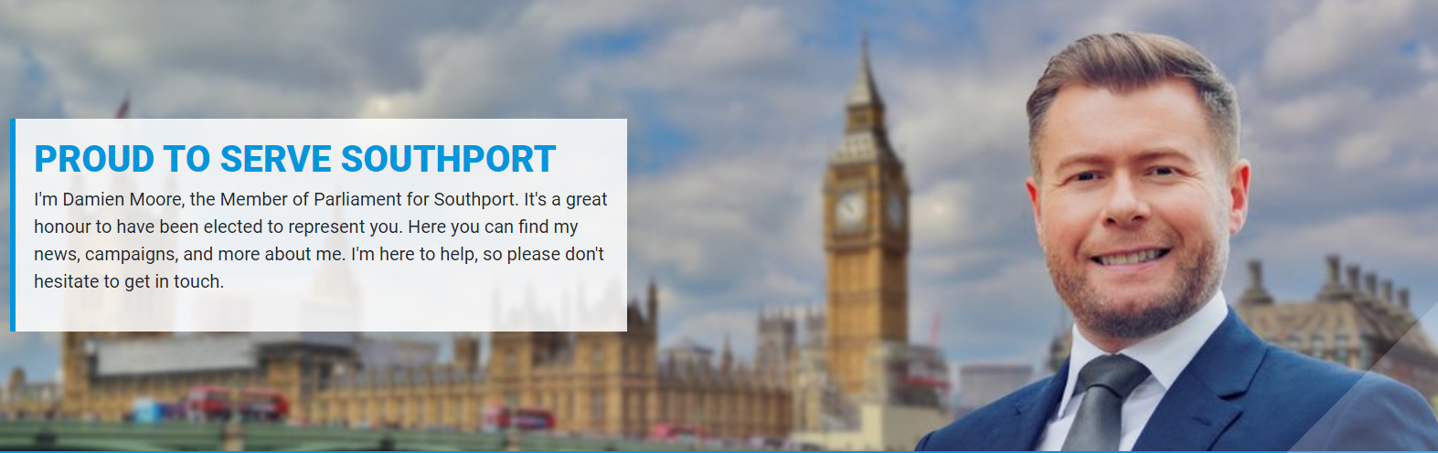
Who is our local MP ?

Slide 11
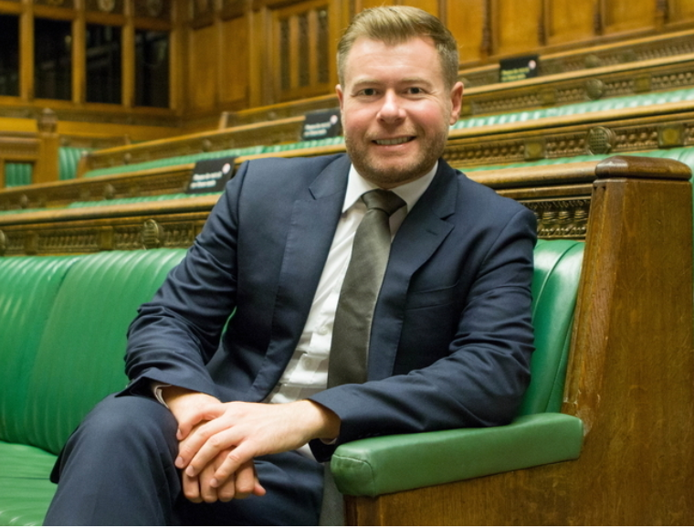
Damien Moore travels to London to sit in the House of Commons to represent the views of people in the town.

Slide 12

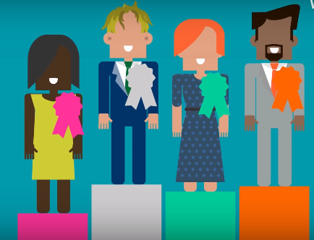
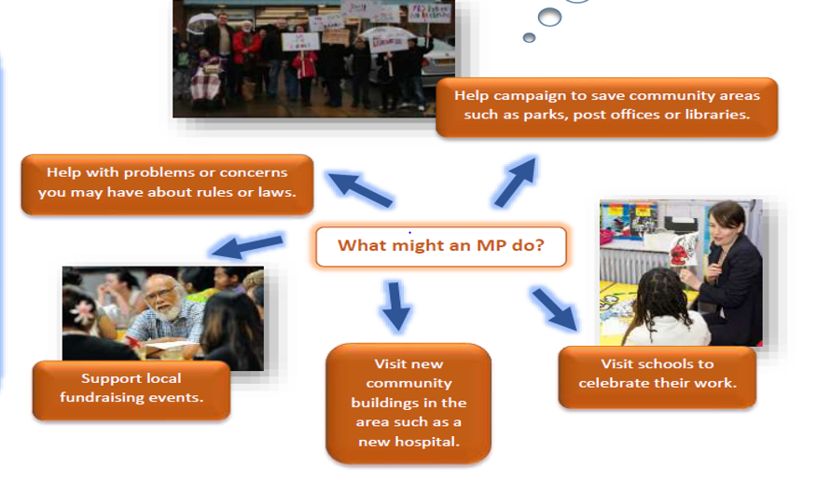
Member of Parliament (MP)
Do you think being an MP is an important job ?

Slide 13
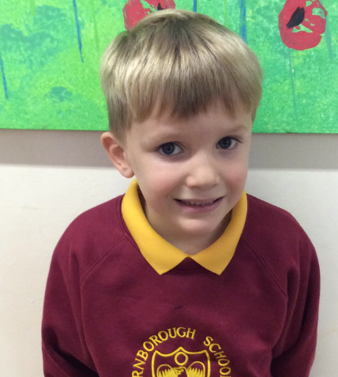
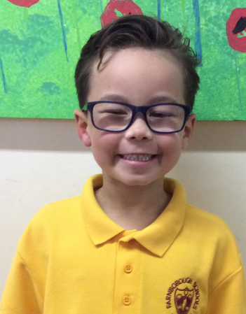
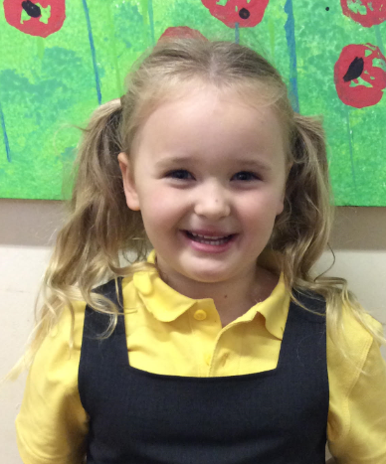
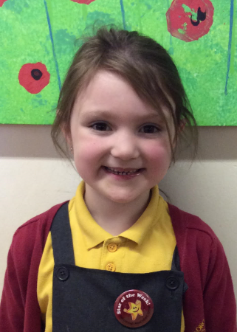
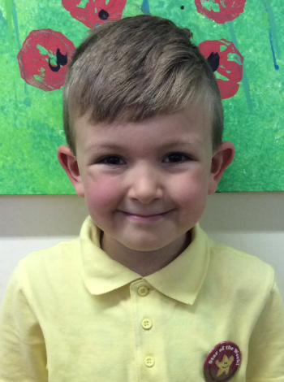
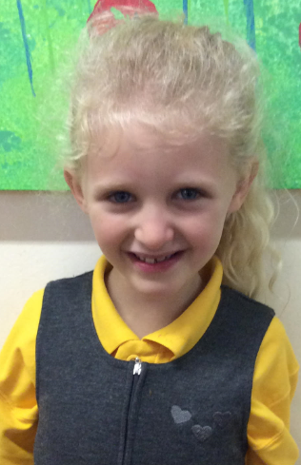
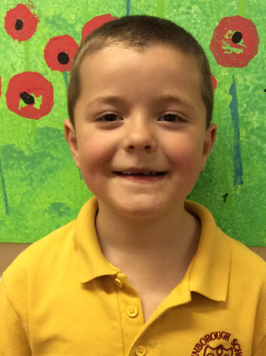
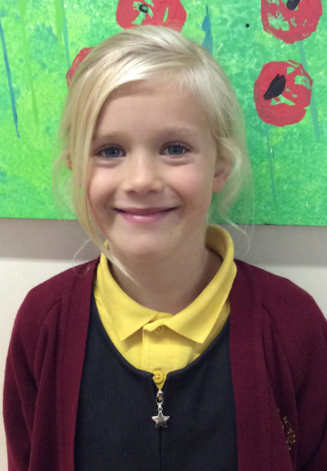
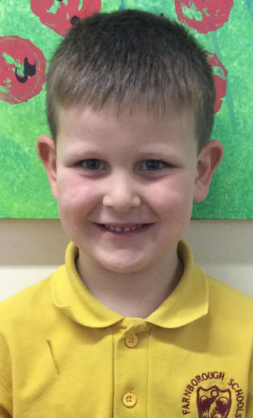
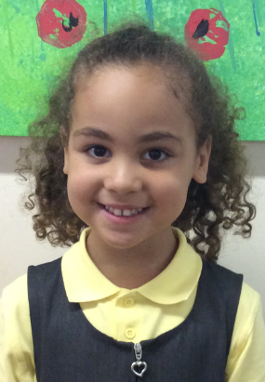
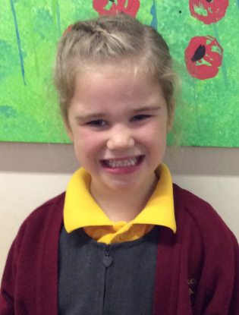
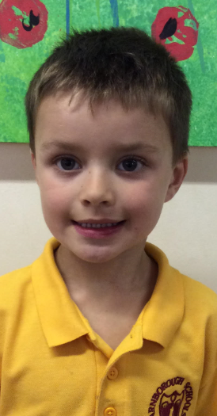
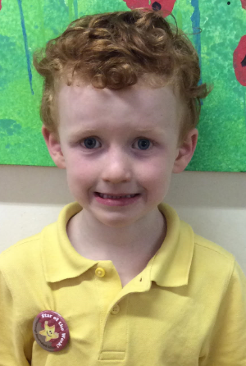
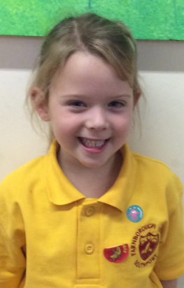
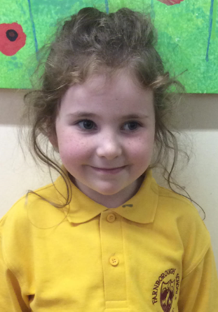
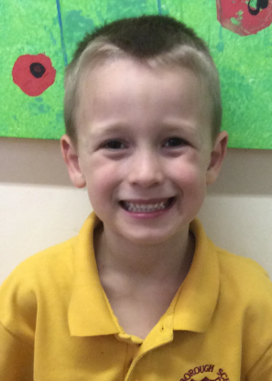
A school council member’s job is a little bit like an MP as they attend meetings to represent your class, sharing your ideas or raising any questions that you may have.

Slide 14
Prayer
Dear God,
We all have different values and opinions on how our country should be run. The UK is a democracy, meaning all adults can have a say and influence change – this includes change about how decisions are made in Parliament.
Help us all to use our voice if we have questions, ideas or opinions to share. Amen

Slide 15
This Week’s Useful Vocabulary
Decision – choosing what should be done after considering all possible actions.
Democracy – a system of government where people choose their rulers by voting for them in elections.
Disapproval – showing or expressing disliking or disagreeing with someone or something.
Parliament – the group of people who make or change laws and decide what policies a country should follow.
Represent – to speak or act for another person or group of people.
Tradition – a custom or belief that has existed for a long time.

Slide 16

How does it make me feel?
sad | angry | happy | confused | excited | worried | shocked | afraid
despondent disconsolate dismal doleful downhearted forlorn gloomy melancholic miserable woeful wretched | aggrieved annoyed discontented disgruntled distressed exasperated frustrated indignant offended outraged resentful vexed | beaming buoyant cheery contented delighted enraptured gleeful glowing joyful | addled baffled bemused bewildered disorientated indistinct muddled mystified perplexed puzzled | animated elevated enlivened enthusiastic exhilarated exuberant thrilled | agitated anxious apprehensive concerned disquieted distraught distressed disturbed fretful perturbed troubled uneasy | astonished astounded disconcerted distressed dumbfounded horrified staggered startled stunned surprised | alarmed apprehensive daunted fearful frantic horrified petrified terrified

