Slide 1

Mutual Respect for and tolerance of those with different faiths and beliefs and for those without faith.

Slide 3
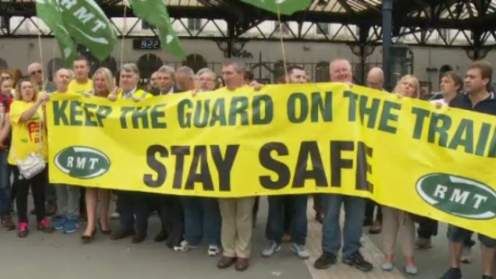
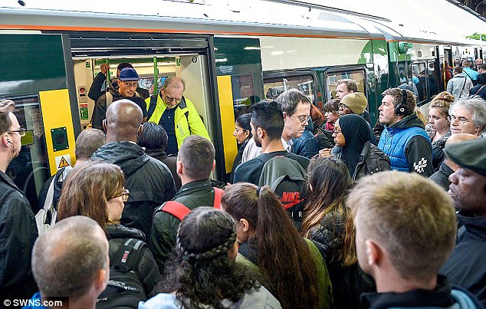
What’s going on this week?
This week, the railway company Southern Rail have organised three strikes to take place as they feel that some of the changes being introduced, including no longer having a worker outside each train to ensure passengers can get on and off the trains safely are unfair and potentially dangerous.

Slide 4
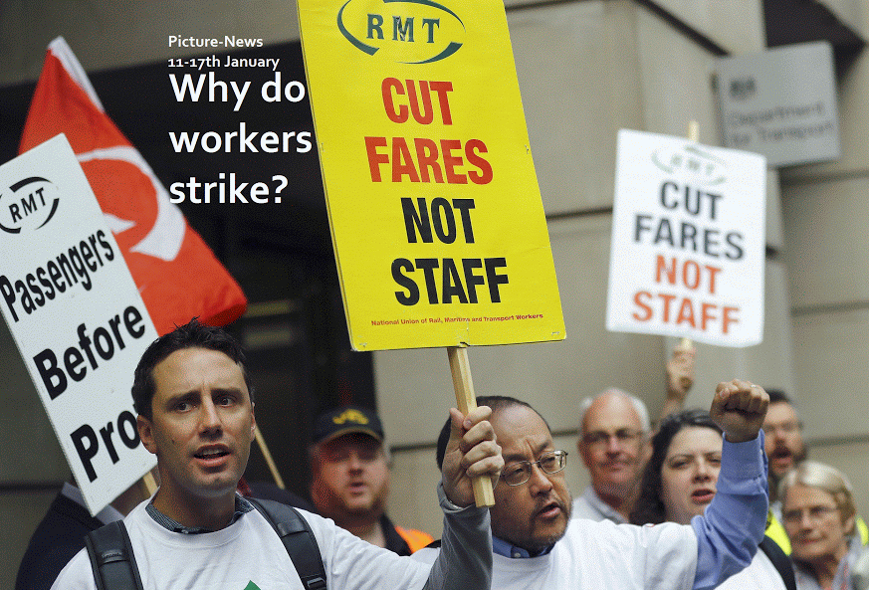

Slide 5
What is a strike ?
A strike is when a group of workers agree to stop working when they disagree with some of their working conditions.
May be the hours people work, not having breaks or not being paid enough.

Slide 6
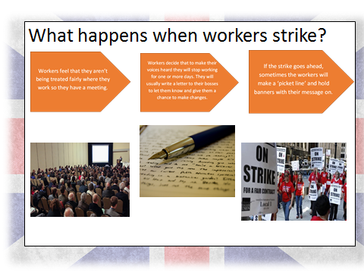

Slide 7
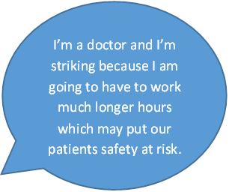
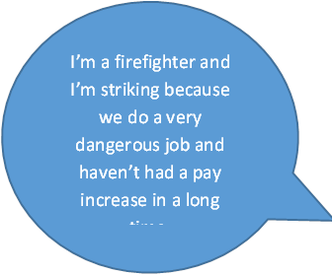
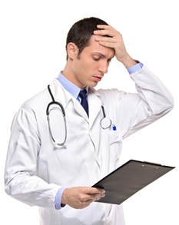
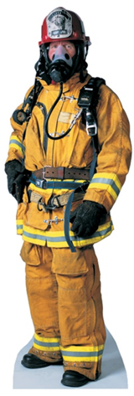
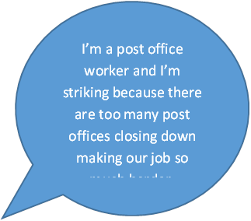
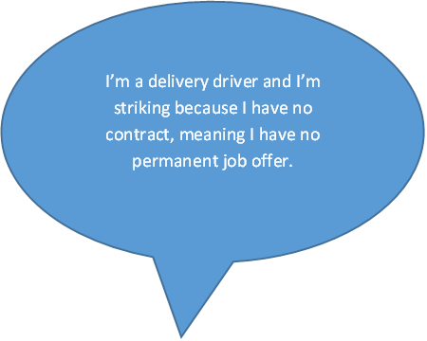
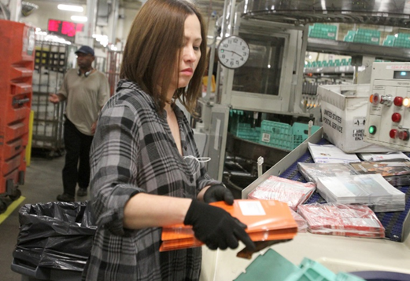
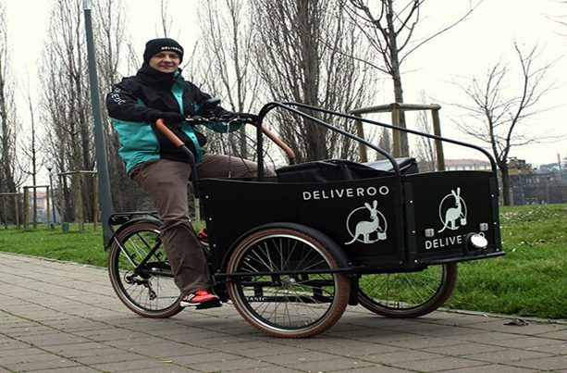
Why do workers strike?

Slide 8
Do you think the workers have good reasons for striking?
Is striking an effective way to bring about change?
How else can people come to an agreement ?

Slide 9
Listen, think, share
Can you think of a time when they’ve felt very strongly about something or something that they feel has been unfair.
Like not having your turn of a toy or game when you are told to go for lunch or when you are unable to stay for an after-school club because you have a dentist appointment.
Sometimes things aren’t always fair for adults too at work. They maybe aren’t given enough money or time to do their job properly so they decide as a group to stop working for a day and let people outside their work and their bosses know how they feel.

Slide 10
Prayer
Dear God
Help us to understand that things might not always be fair in life.
But help us to find ways of making things as fair as possible.
Help us to tell an adult in school if we see things that are not fair so they can support us in making things right.
Amen

