Slide 1

Mutual Respect for and tolerance of those with different faiths and beliefs and for those without faith.

Slide 2
British Values
Picture News 18th-24th January Respect
We understand the importance of conserving special places and we will show respect for these places.

Slide 3

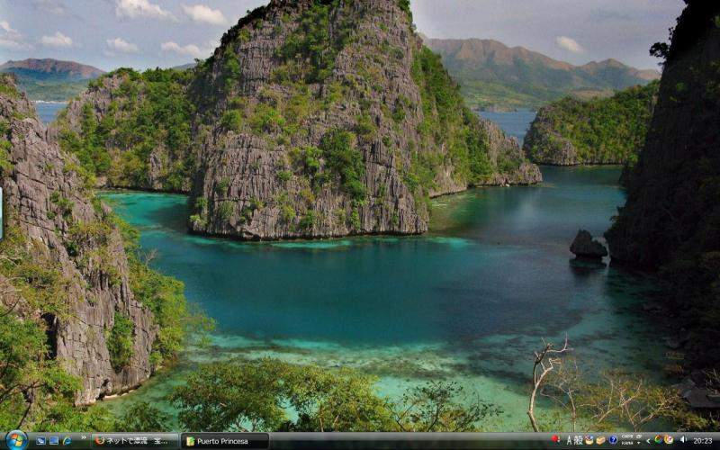
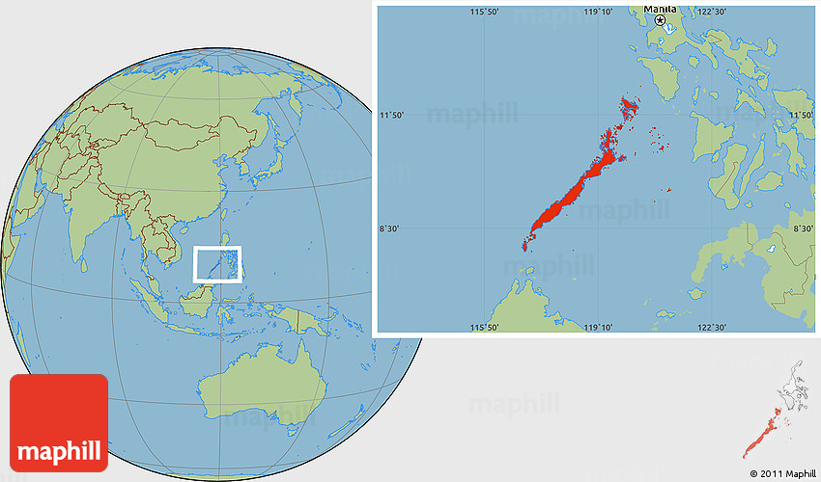
What’s going on this week?
The Philippine environment minister has said that the American children’s television channel ‘Nickelodeon’ will not be allowed to build an underwater theme park on one of the country’s protected islands.

Slide 4
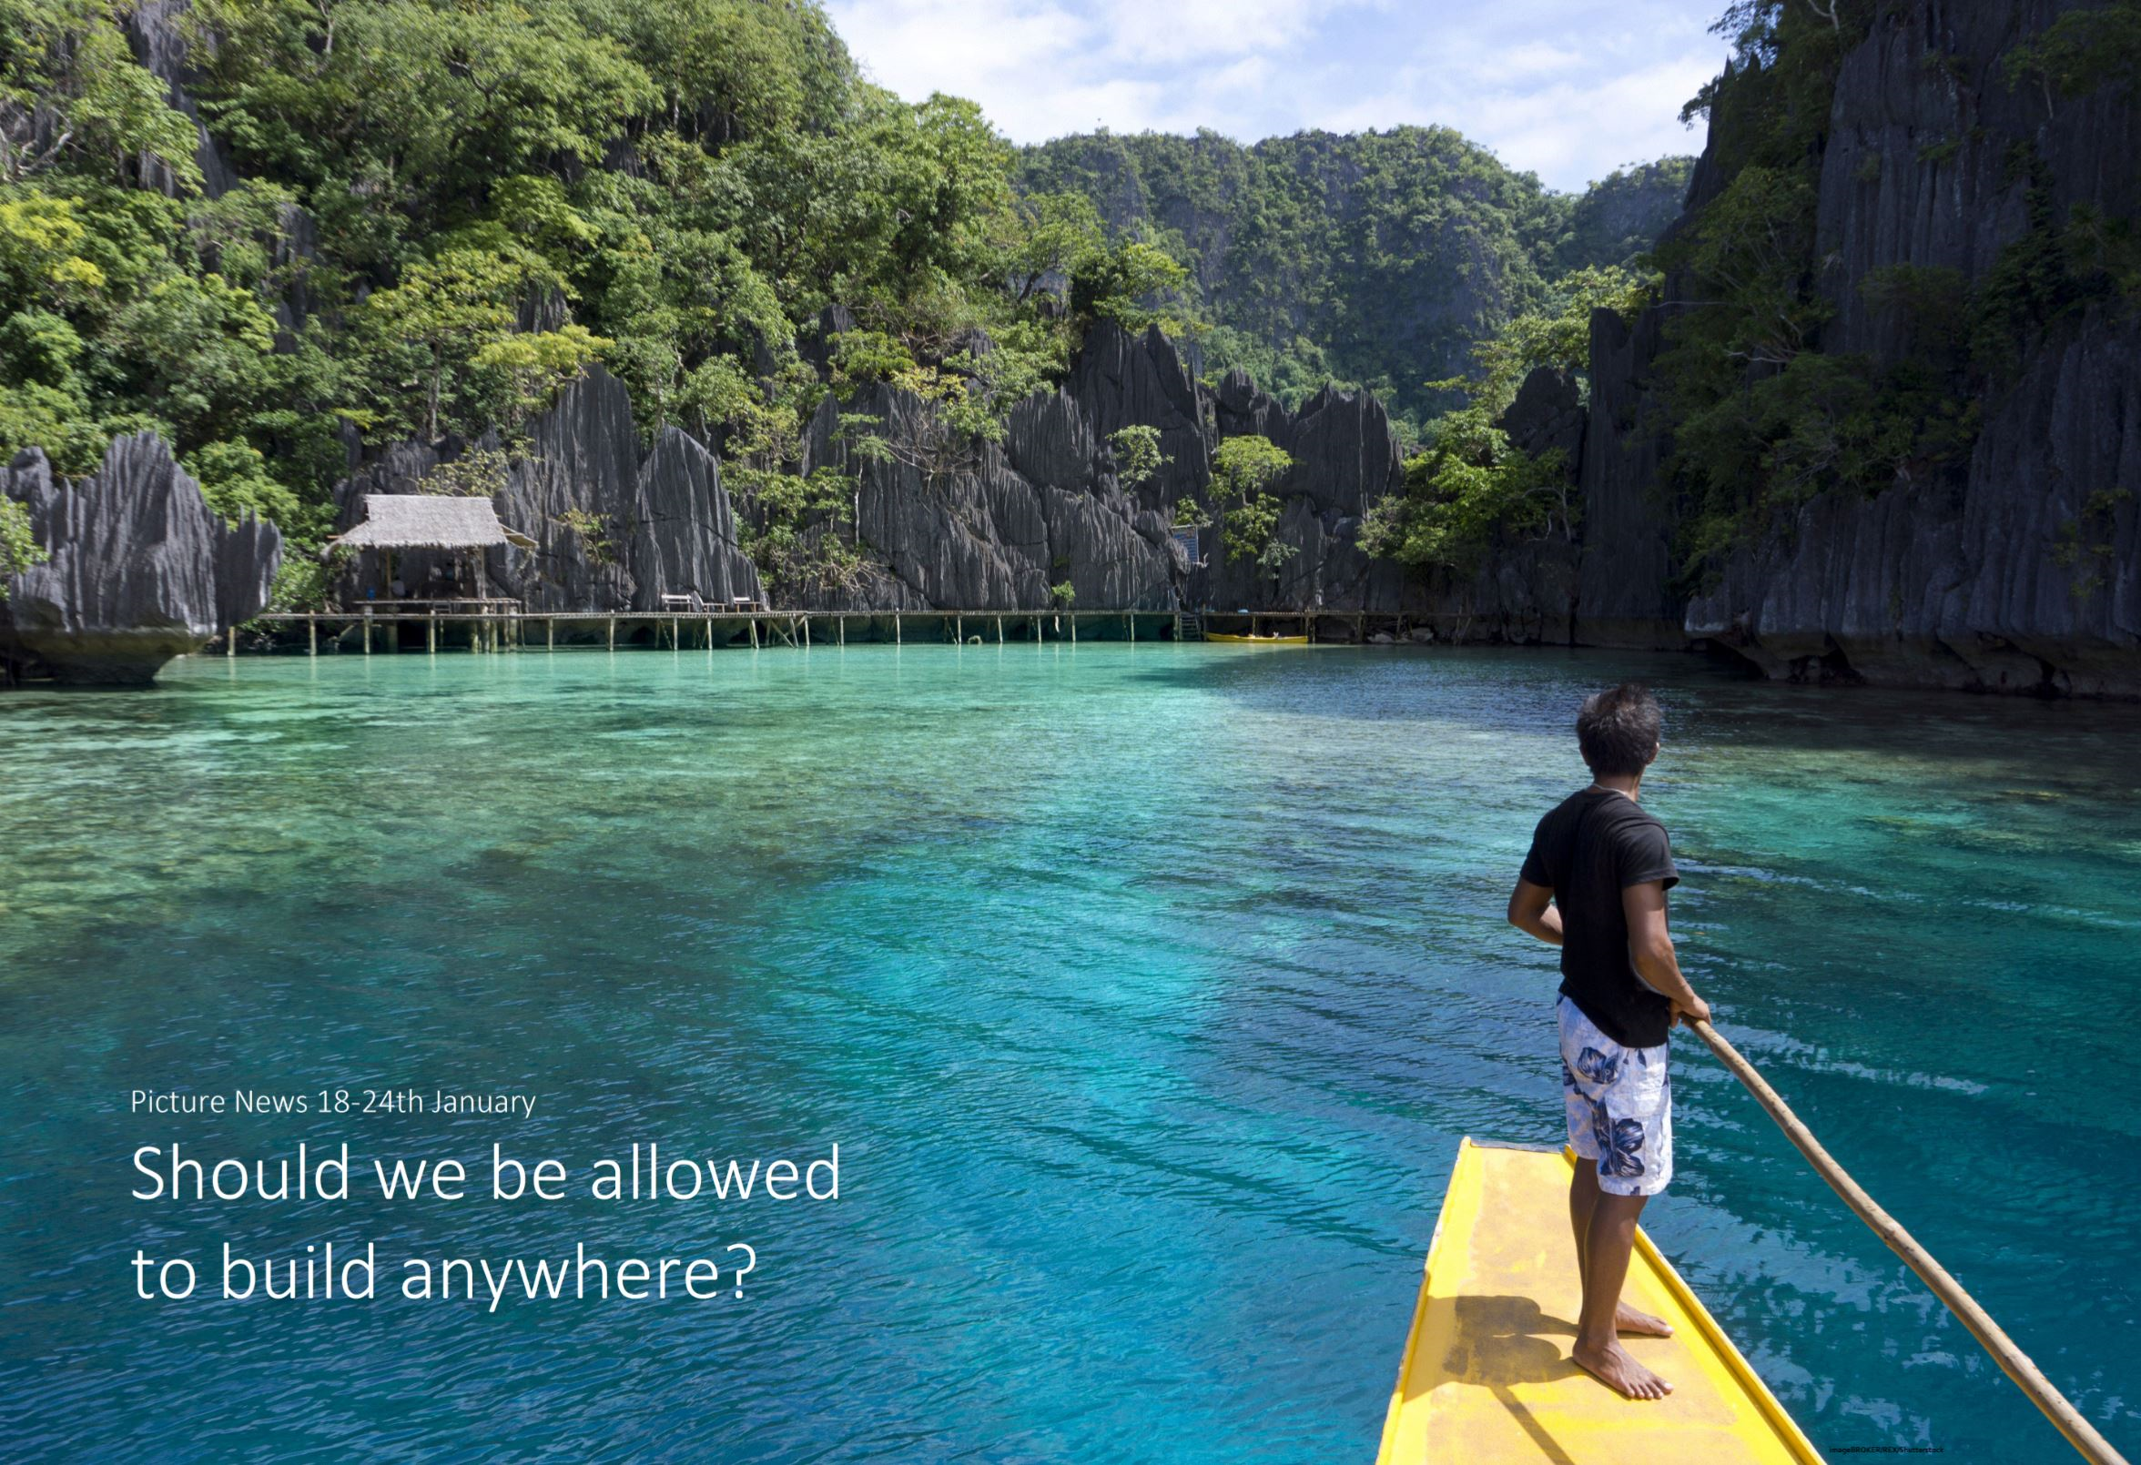

Slide 5
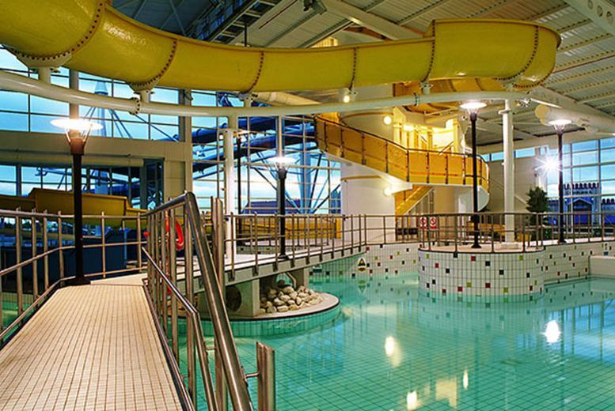
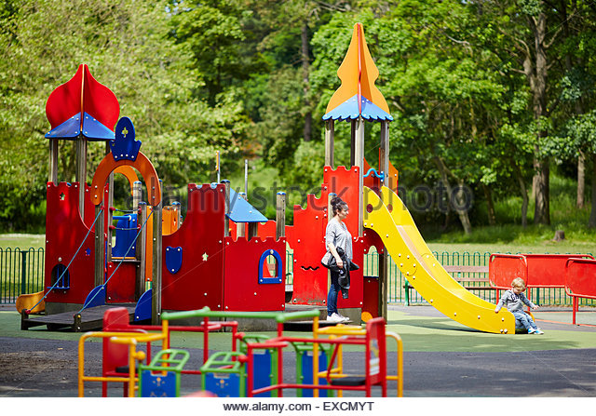
Special Places
Have you got a special place ?
It could be home/school a favourite park or swimming pool.
What is it that makes these places special?

Slide 6

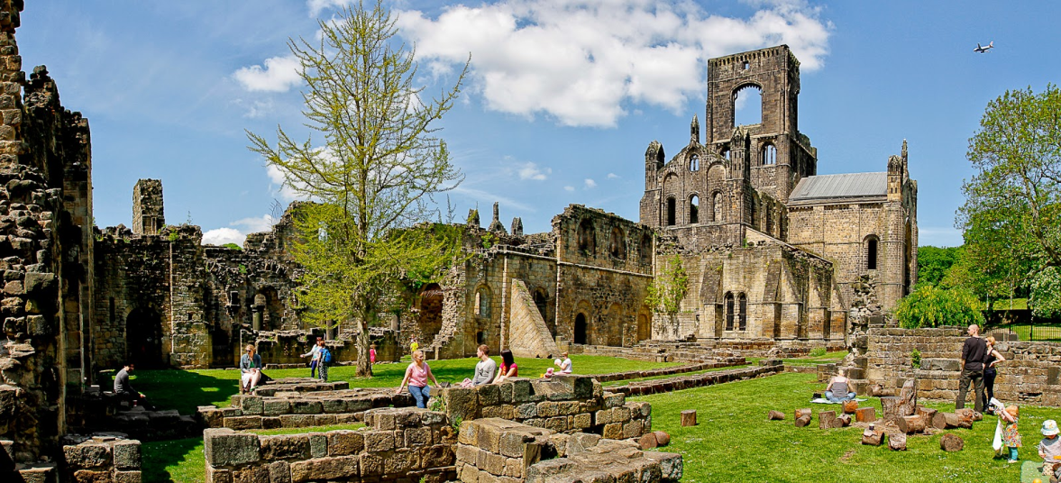
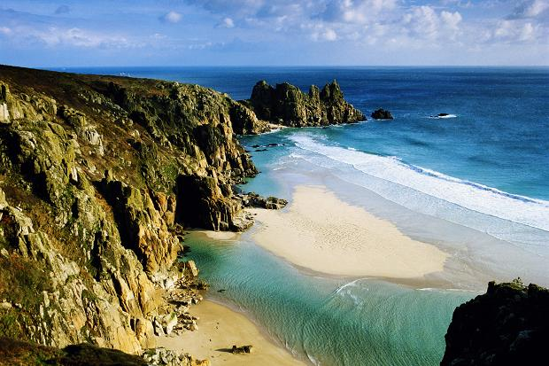
What makes these places special?
Kirkstall Abbey, Leeds
What makes these places special? Why do we not allow any new buildings to be built near them?
Lands End, Cornwall

Slide 7
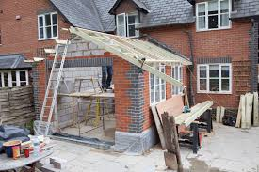
Have you ever had an extension on their house or experienced building a new house?
There are many processes of planning permission, which take time. Lots of important people make decisions on whether it’s ok for the building work to start. Is this a fair and a good way to reach a decision?

Slide 8

Prayer
Dear God
There are lots of special places not just around where we live but all over the world.
So we can enjoy them, please help everyone to look after them so that future generations can enjoy them as we have.
Amen

