Slide 1


Slide 2


Slide 3
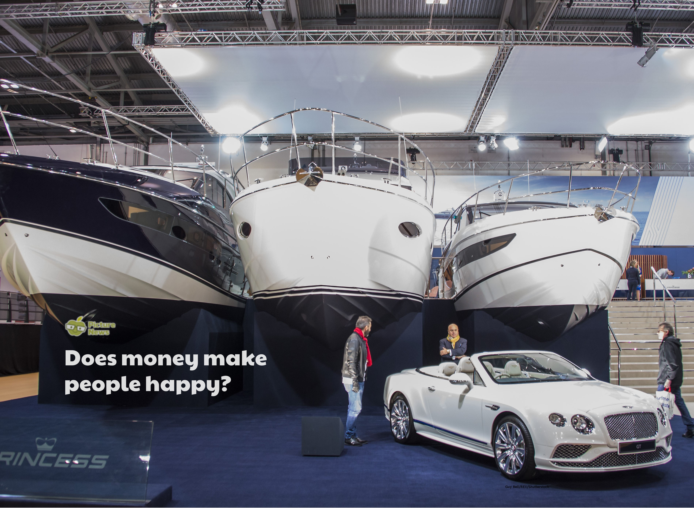

Slide 4
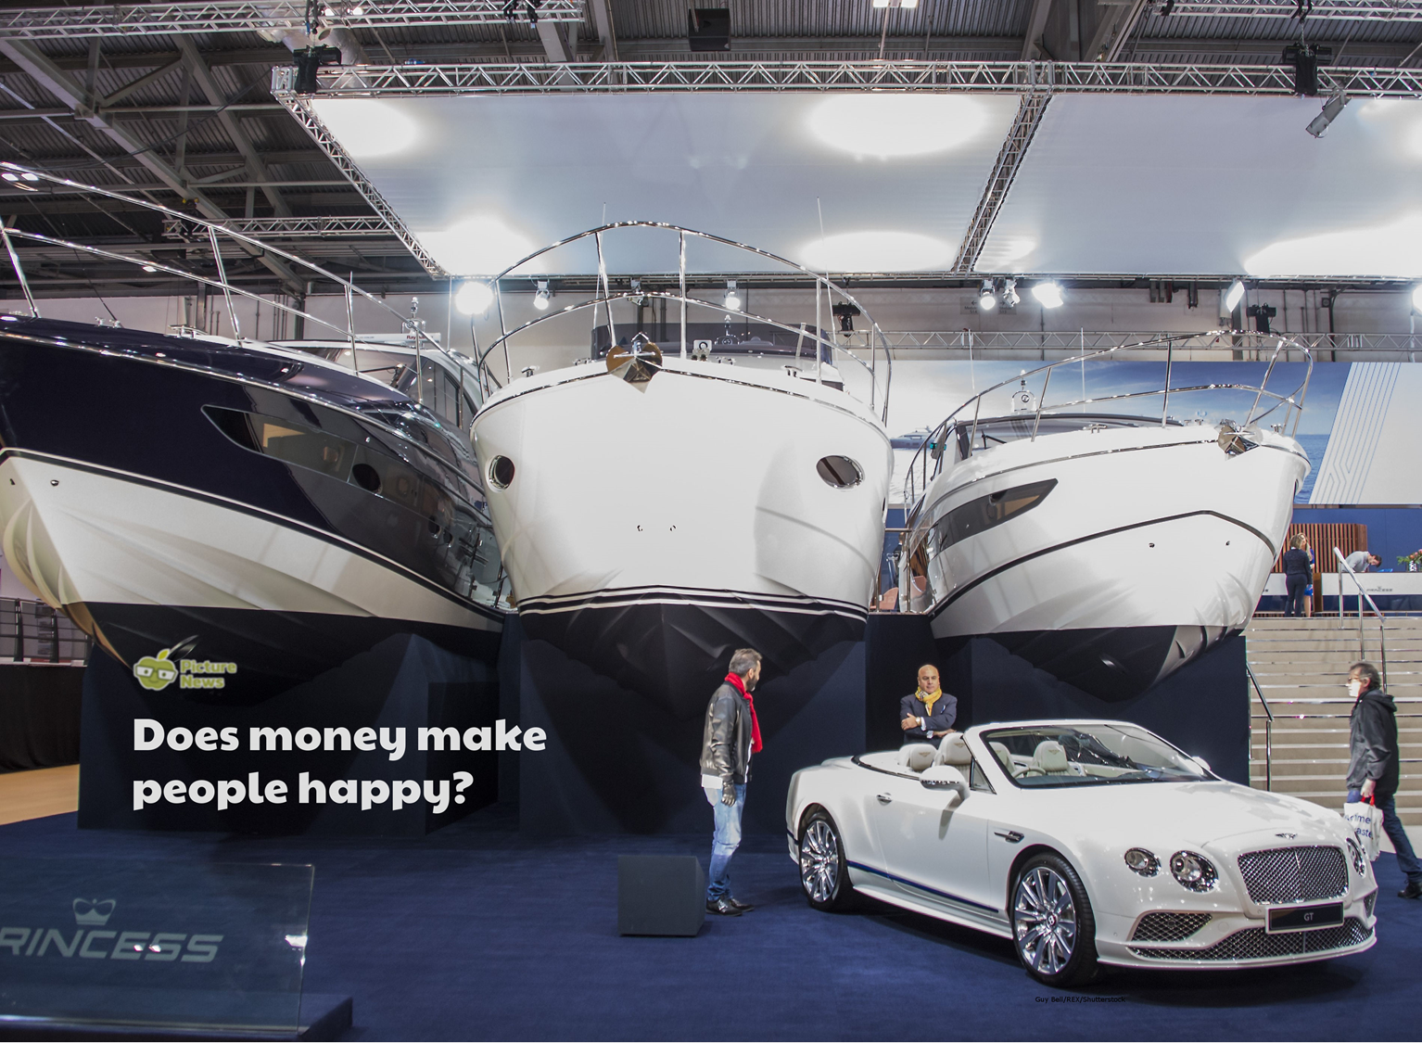
What would you buy if we had a lot of money?
Do we think these things would make us happy?
Do we think that every rich person in the world is happy? Why or why not?
What kinds of things make us feel happy?
Do we think anyone can be happy, regardless of how much money they have?

Slide 5
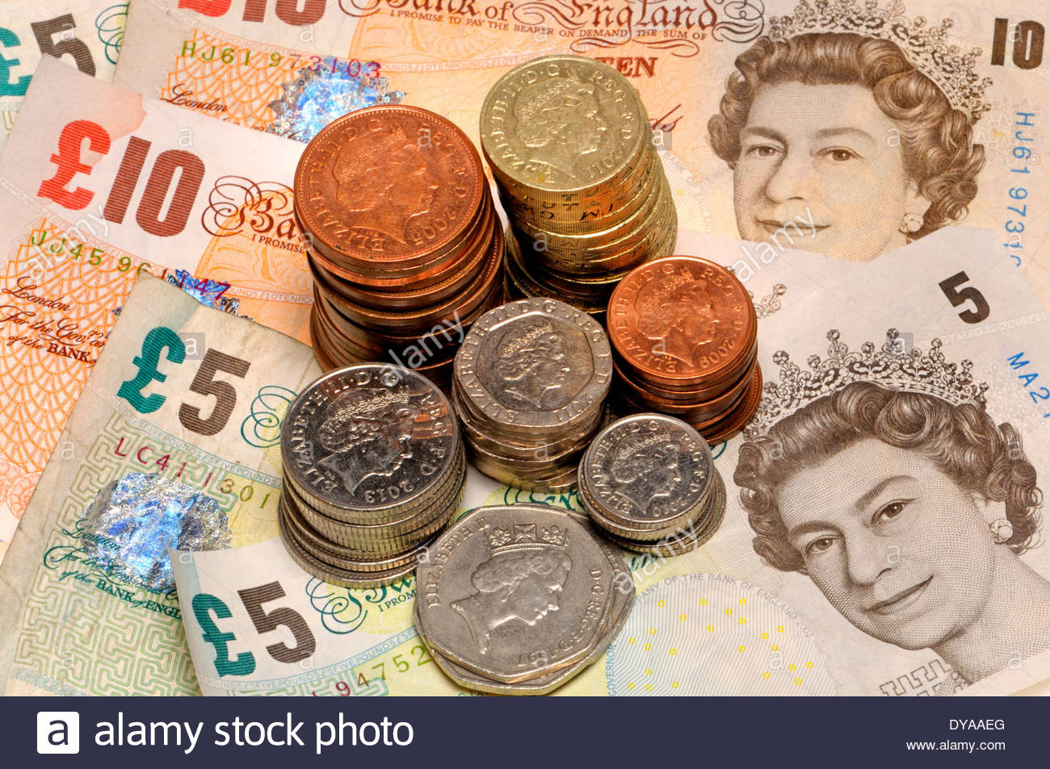
Why do we have money?
What do we spend money on ? How do we pay for things ?
Where does money comes from?
All involve exchange of money. There isn’t an endless supply of money. Some people around the world have a lot less than we do in the UK.

Slide 6
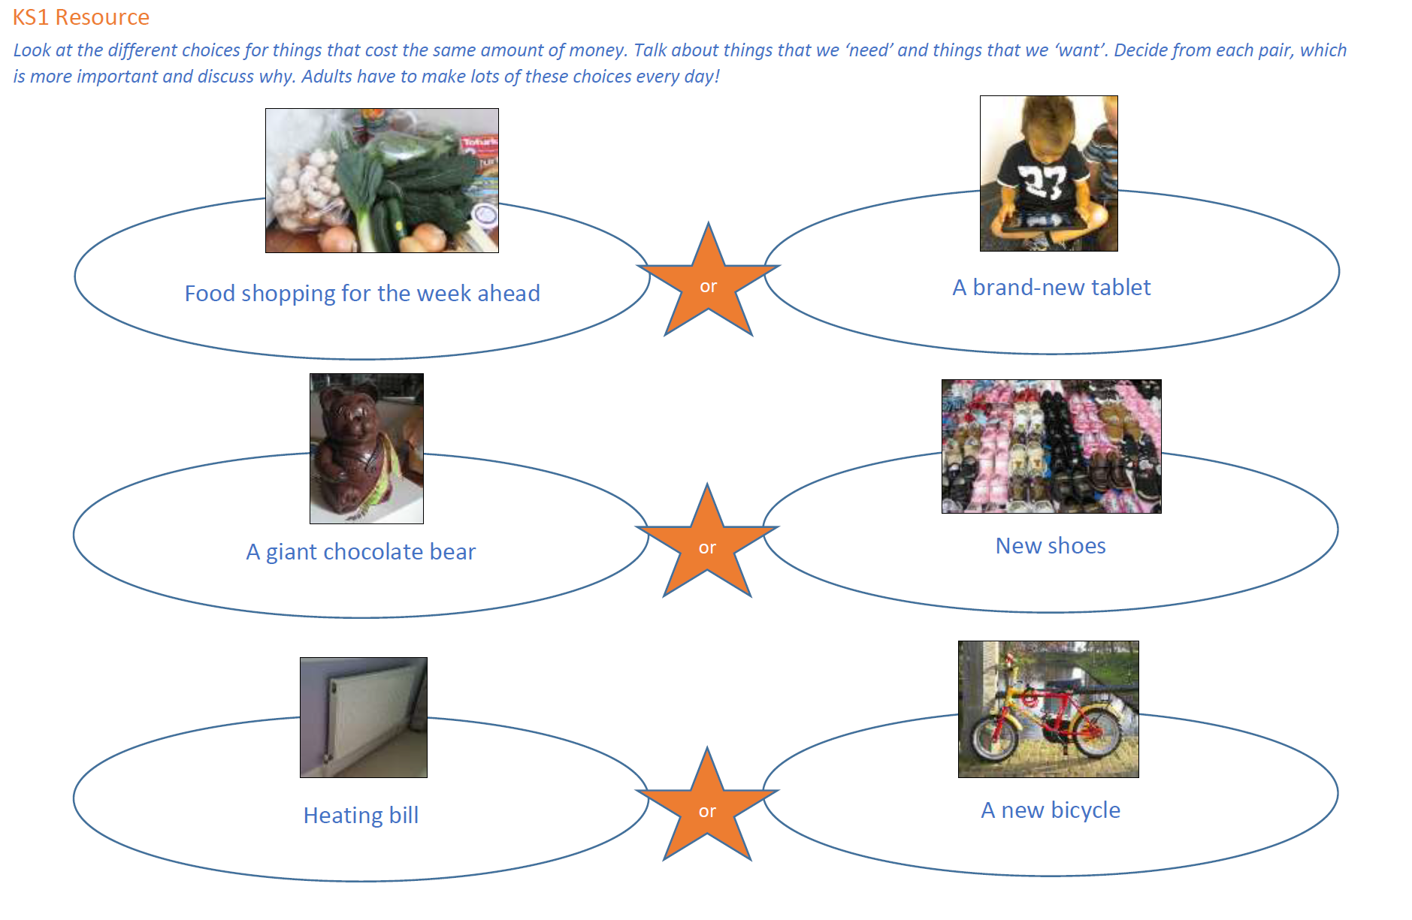

Slide 7
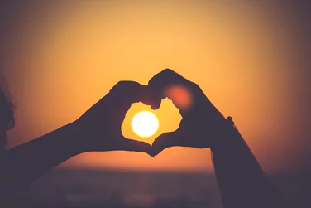
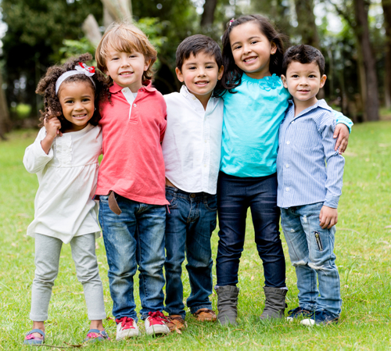
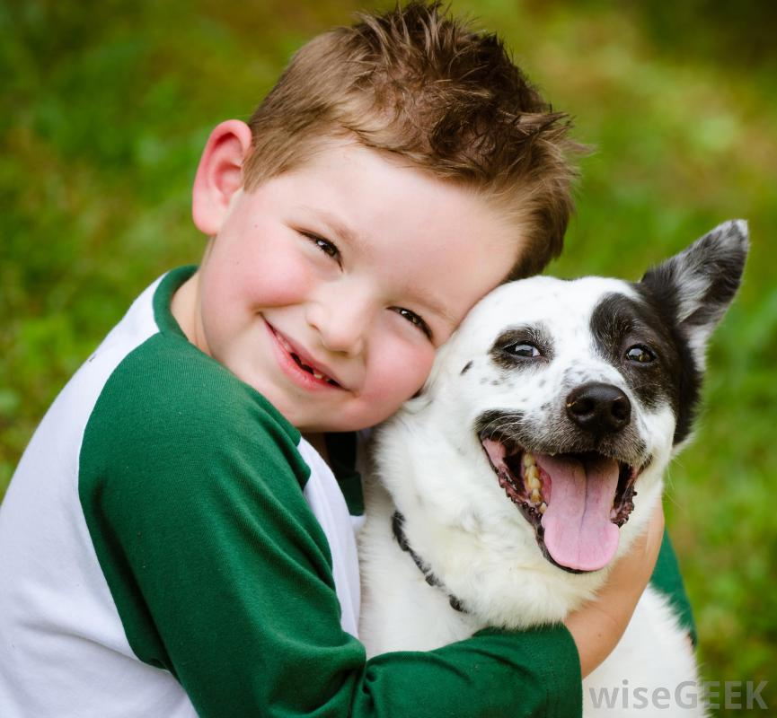
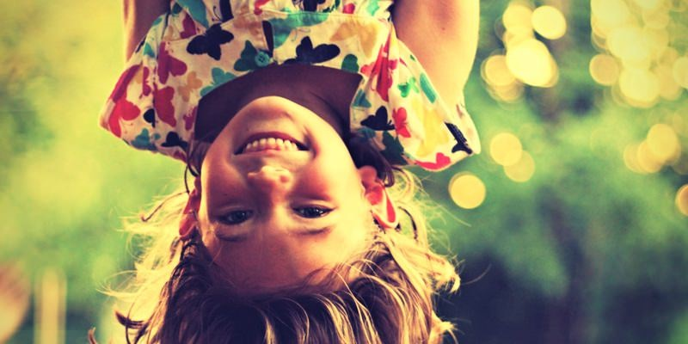
The best things in life are free
What do we think this means?

Slide 8
Prayer
Dear God,
It’s easy to forget how lucky we are. At times we may wish we had more and think that it might make us happier.
Help us to remember that as long as we have everything we need, it’s up to us to choose to be happy and to be grateful for all we do have! Amen

