Slide 1


Slide 2
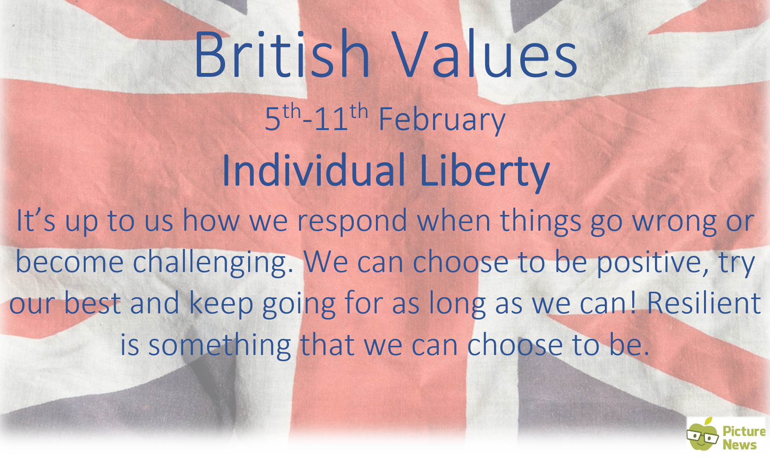

Slide 3
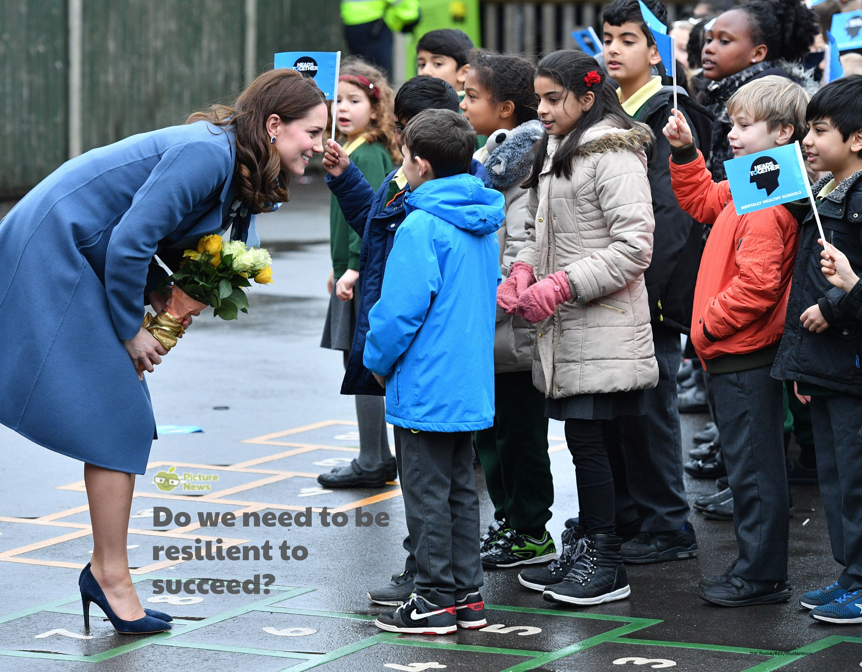

Slide 4
In the news this week…
The 5th-11th February 2018 is Children’s Mental Health Week.
Last Tuesday, MPs heard testimony on the subject of transforming children and young people’s mental health.
This is further evidence that children’s mental health has become a matter of concern for everyone.
Each year, more and more children and teenagers are being diagnosed and suffering from mental health problems.

Slide 5
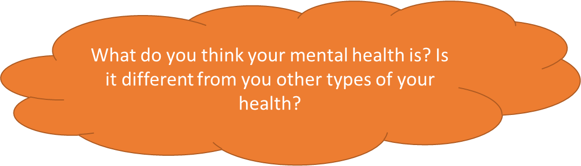
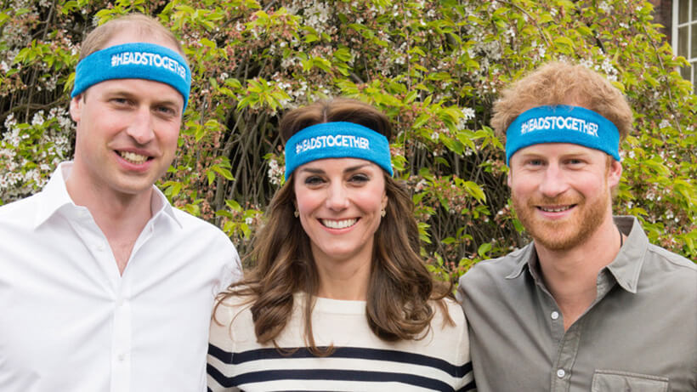

Health ?
Physical Health ? Healthy Eating ?
Mental Health ?
Prince William, the Duchess of Cambridge and Prince Harry work closely with a charity called ‘Heads Together’ which believes in the importance of talking about our thoughts and feelings to help us overcome hard times together.
Difficult things happen to everyone, but the important thing is how we respond to the situation.

Slide 6
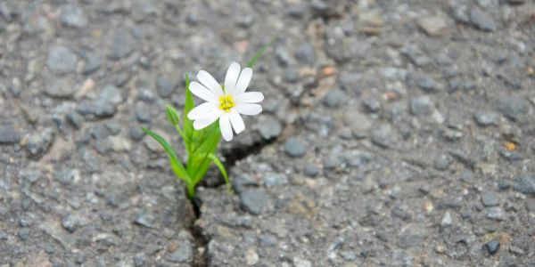
Resilience
A flower growing alone through a crack in the road.
What does resilience mean?

Slide 7
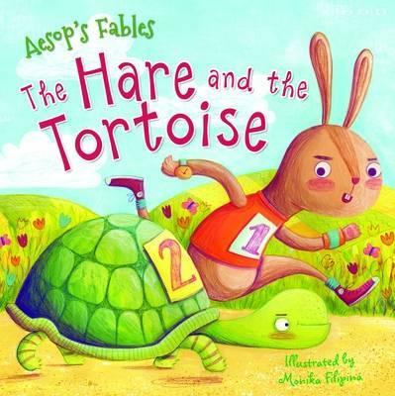
What things do we find difficult?
Do we all find the same things hard?
What do we do when we find things hard?
What can help us keep going when
we find something hard?
Bouncebackability , Perseverance

Slide 8
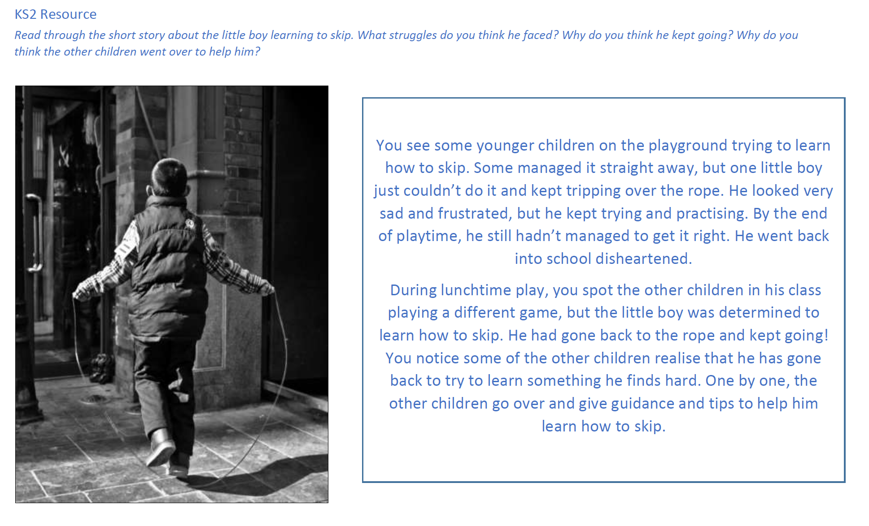

Slide 9
Prayer
Dear God,
Being resilient isn’t a skill or a talent we are born with, it’s something that we can all choose to be!
Help us to persevere, bounce back, be resilient when things are difficult and not give up, so we can try our very best to reach our goals!
Amen

