Slide 1


Slide 2


Slide 3
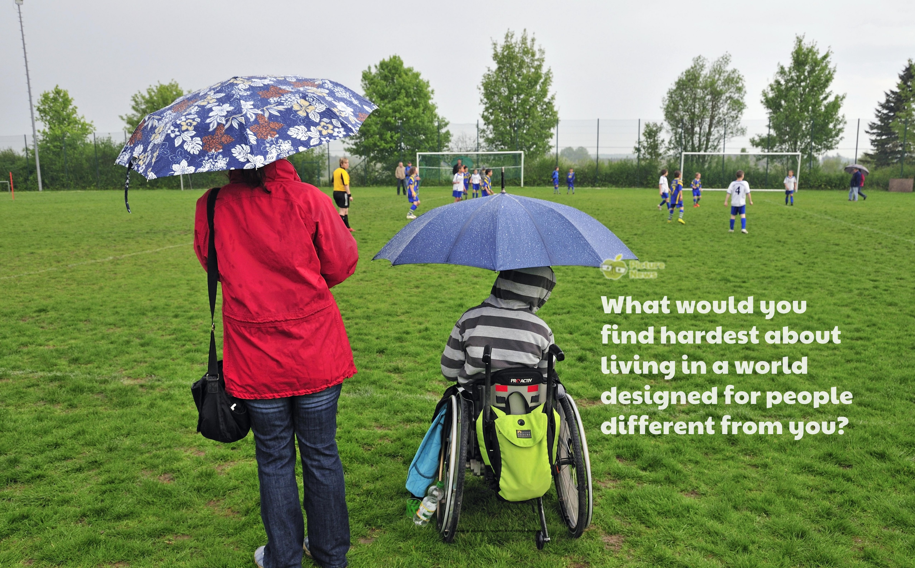

Slide 4
In the news this week…
High street retailer Marks & Spencer has announced the
launch of a new 'easy dressing' range designed for children
with disabilities. There are 106 items, the collection is
especially adapted for youngsters who need 'extra help'
including sensitive skin and feeding tubes. Thought to be a
high street first, the ‘Kids Easy Dressing’ range.
Do you think shops should think more about all their different types of customers when designing clothes?

Slide 5
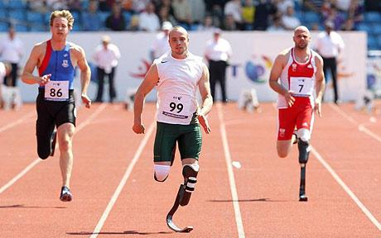
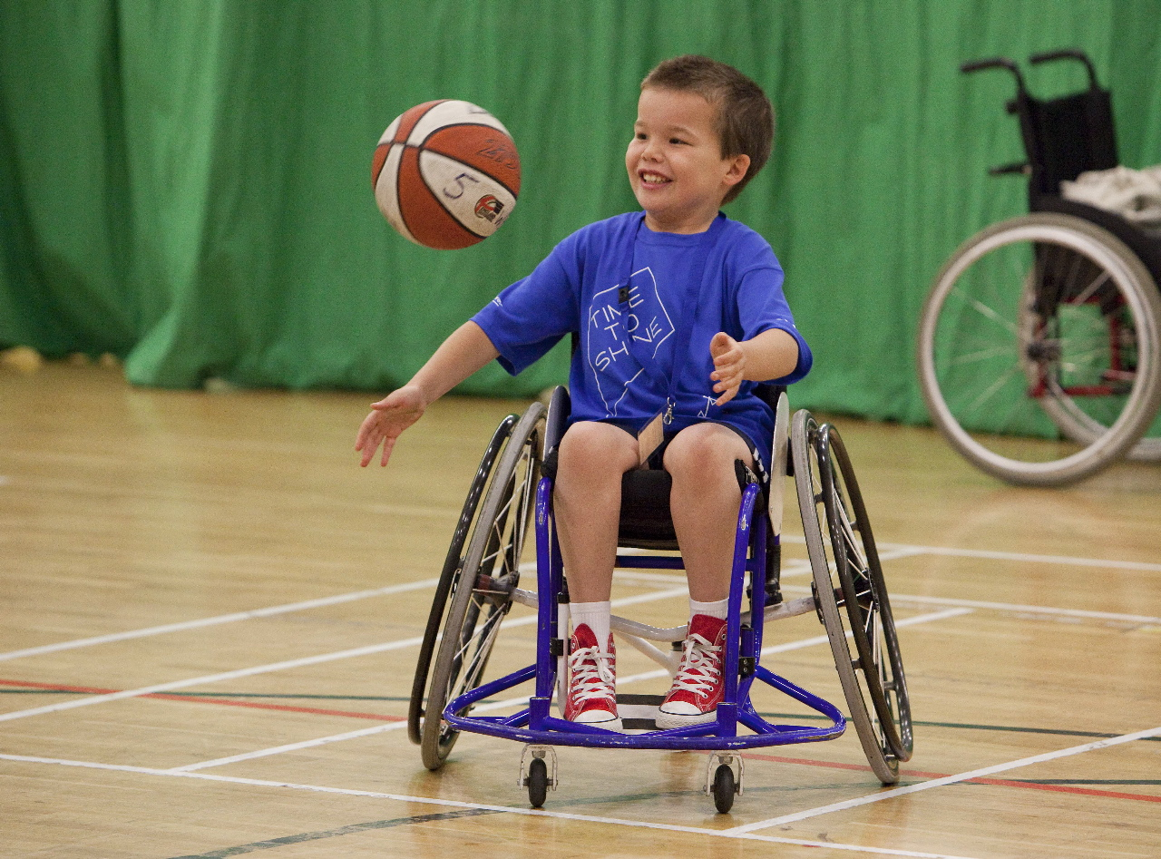
Overcoming Barriers
What do we mean when someone says we have to face or overcome barriers?
All of us find somethings difficult and other things easy, so for some of us,
running a race might be easy – if we are good at running, but if we find running
difficult, we may need to overcome barriers.
People who have disabilities, will often face barriers in their everyday lives.
Some people can’t walk so may need to be in a wheelchair, some people can’t hear or see.
Discuss how these might affect everyday activities e.g. going to the shops, listening to the teacher or watching TV.
How would you do it differently?

Slide 6
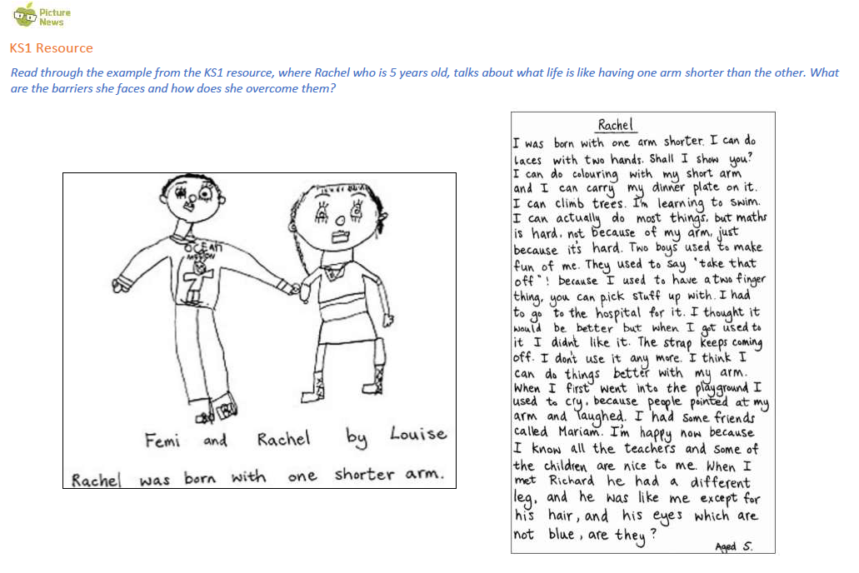

Slide 7
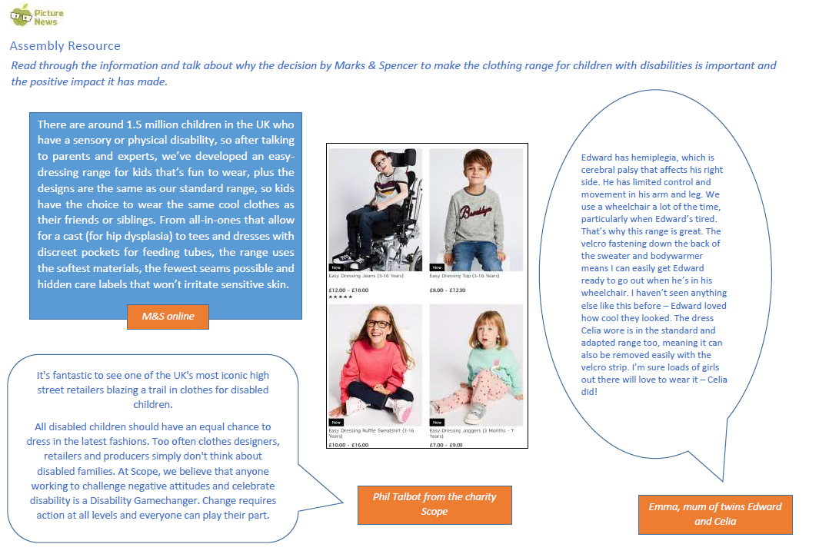

Slide 8
Prayer
Dear God,
It’s easy for us to forget as we go about our day to day
lives, that not everyone is able to do everyday activities in
the same way.
It’s important we play our part in supporting others, so they are included, respected and valued.
Help us to remember to think about everyone, and to make sure we do all we can to help others join in.
Amen

