Slide 1
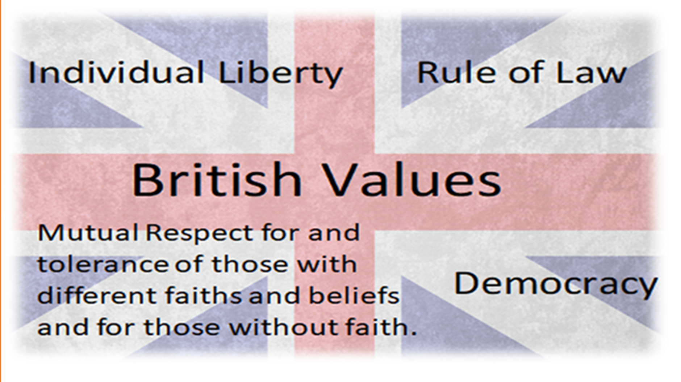

Slide 2
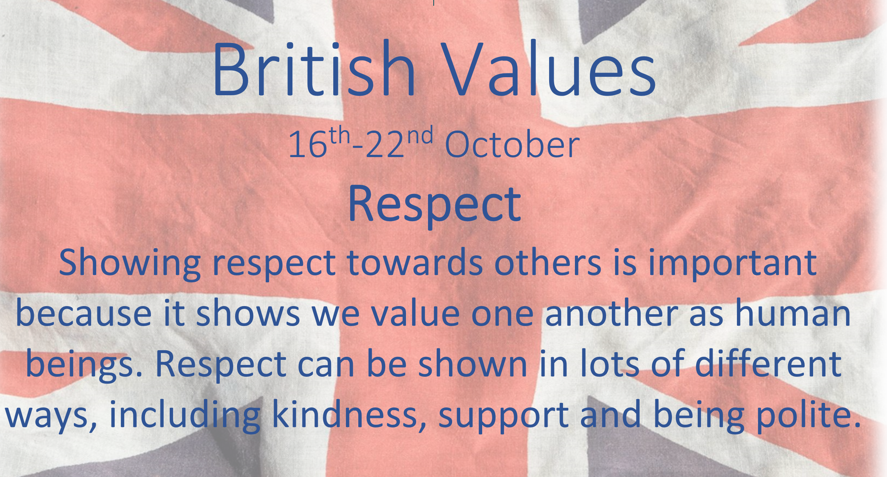

Slide 3
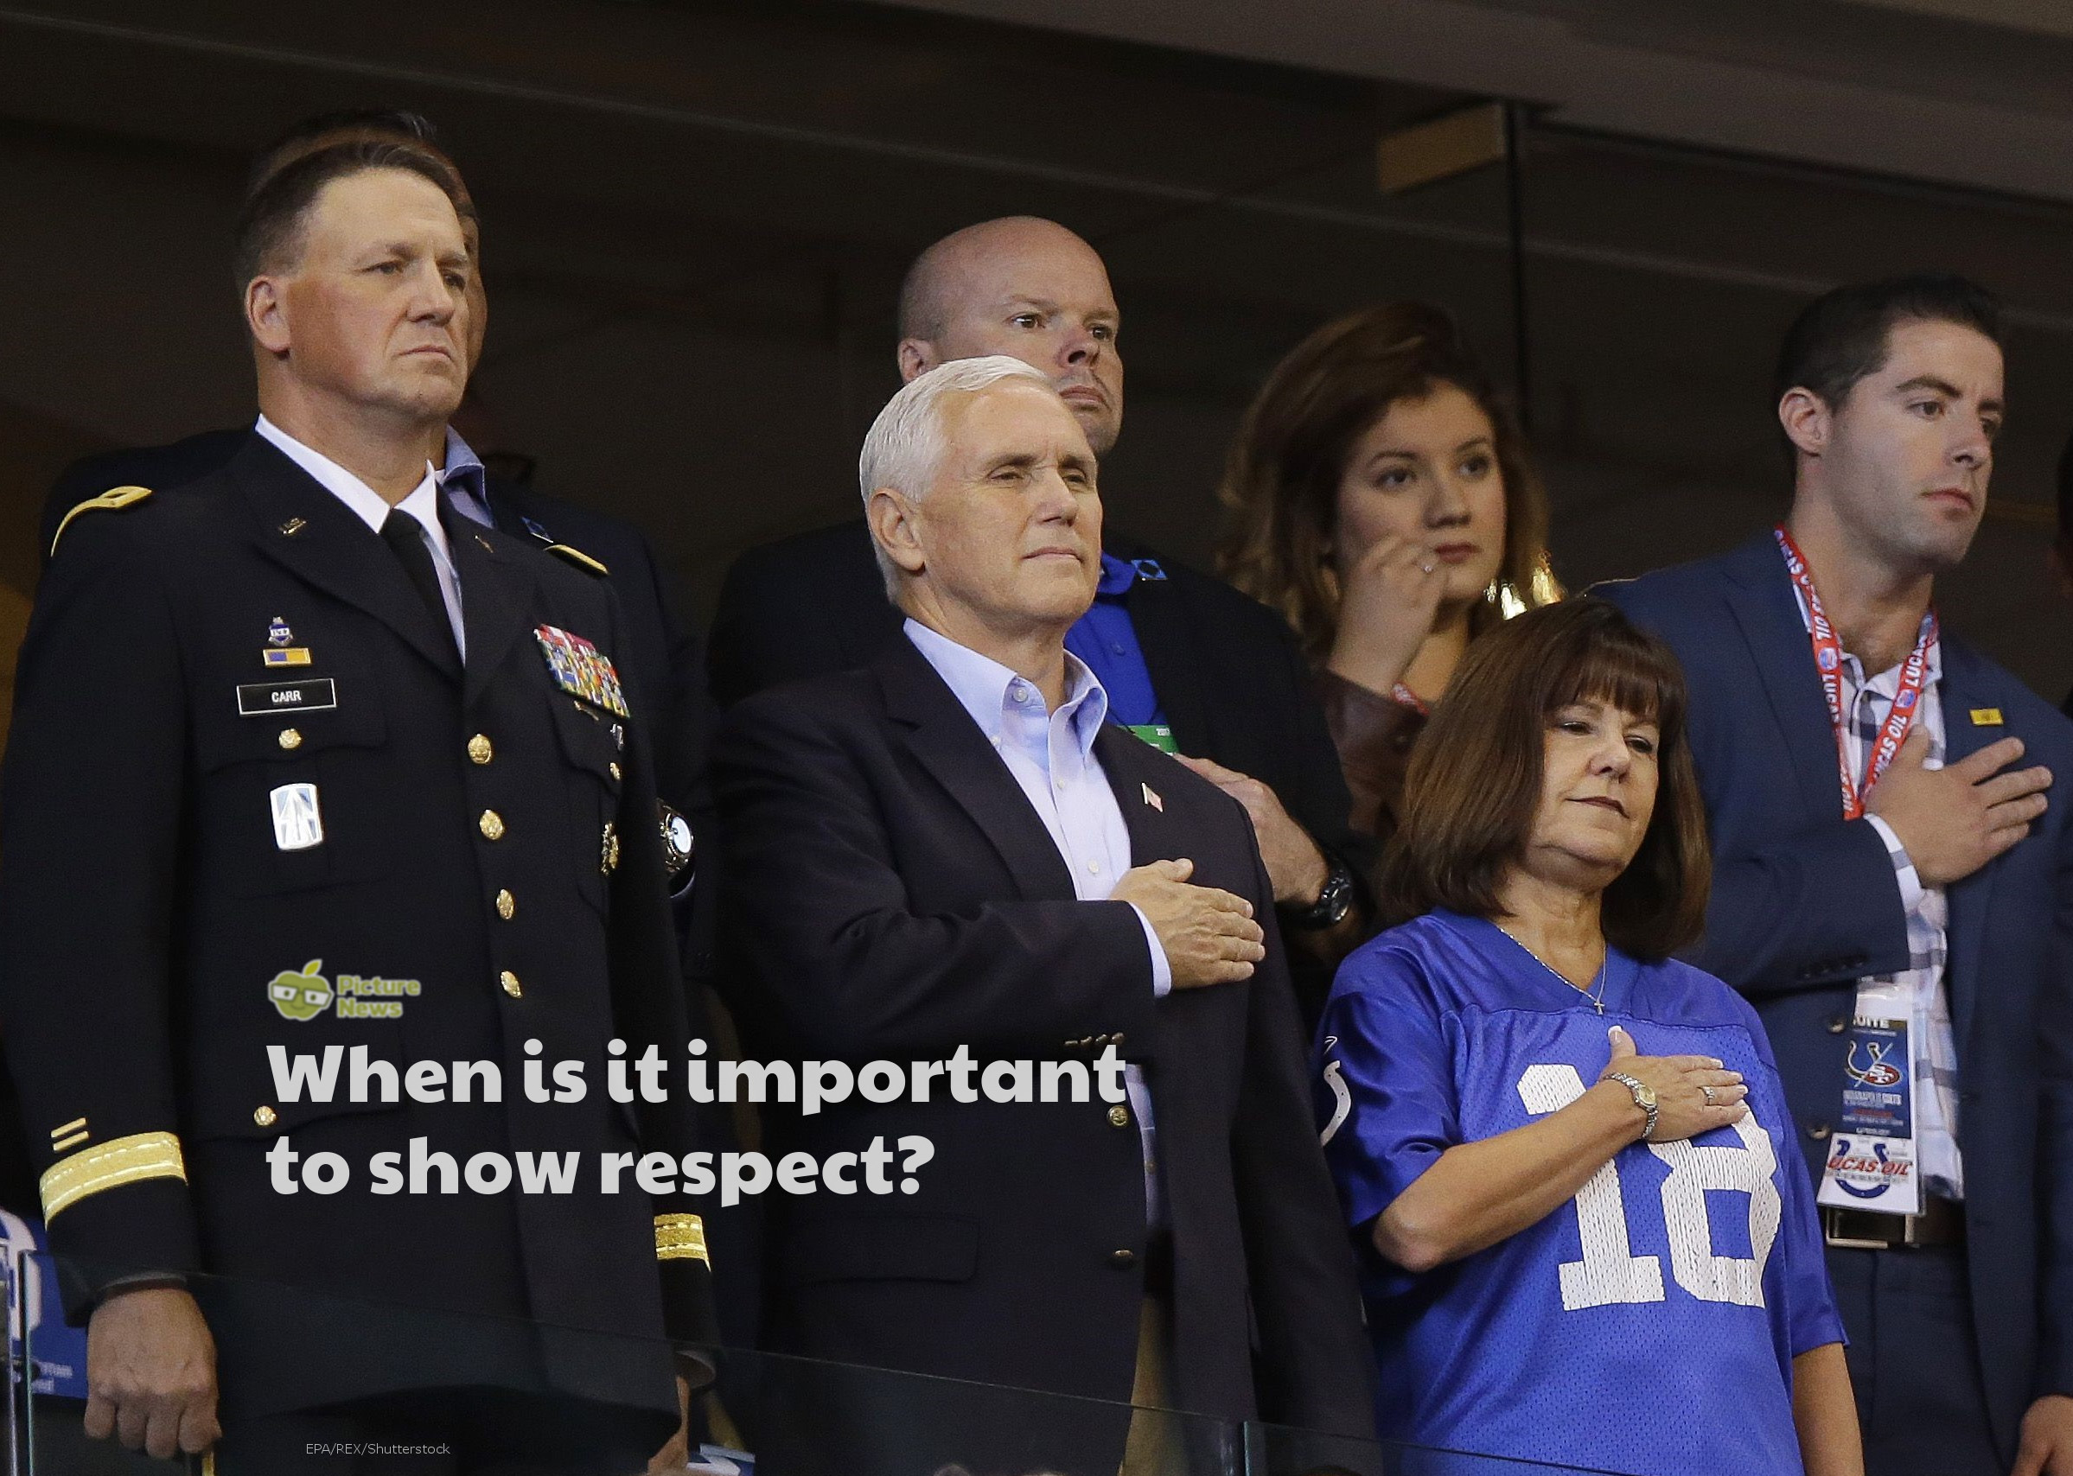

Slide 4
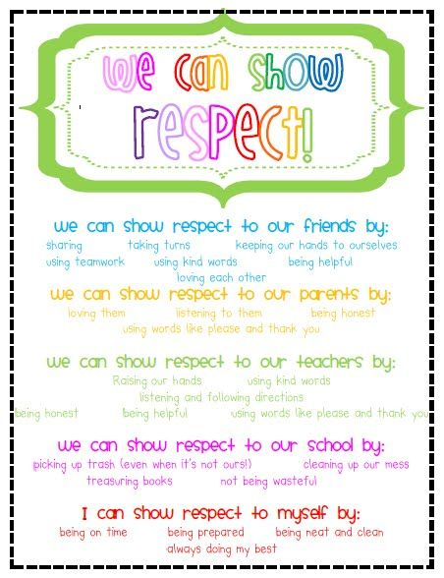
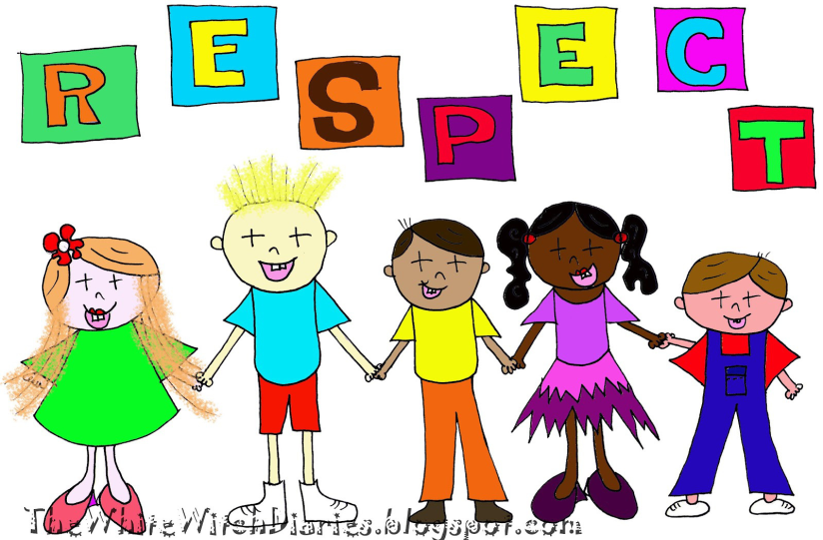
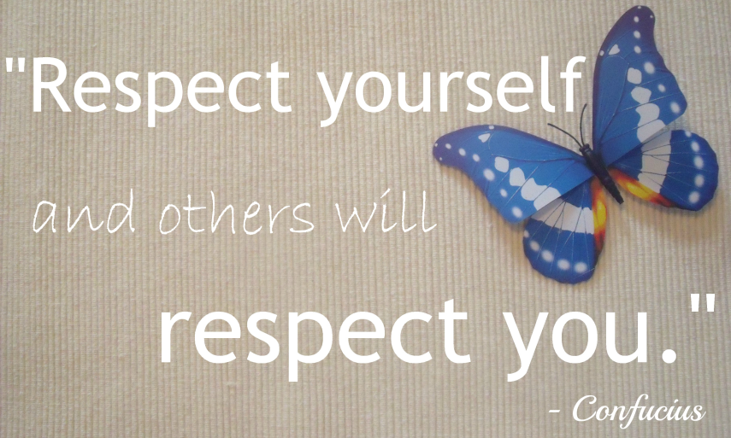
What does RESPECT mean?
Importance of being :
Kind
Helping others
Polite
Equal
Respecting our belongings
Respecting the things that we
have in school.

Slide 5
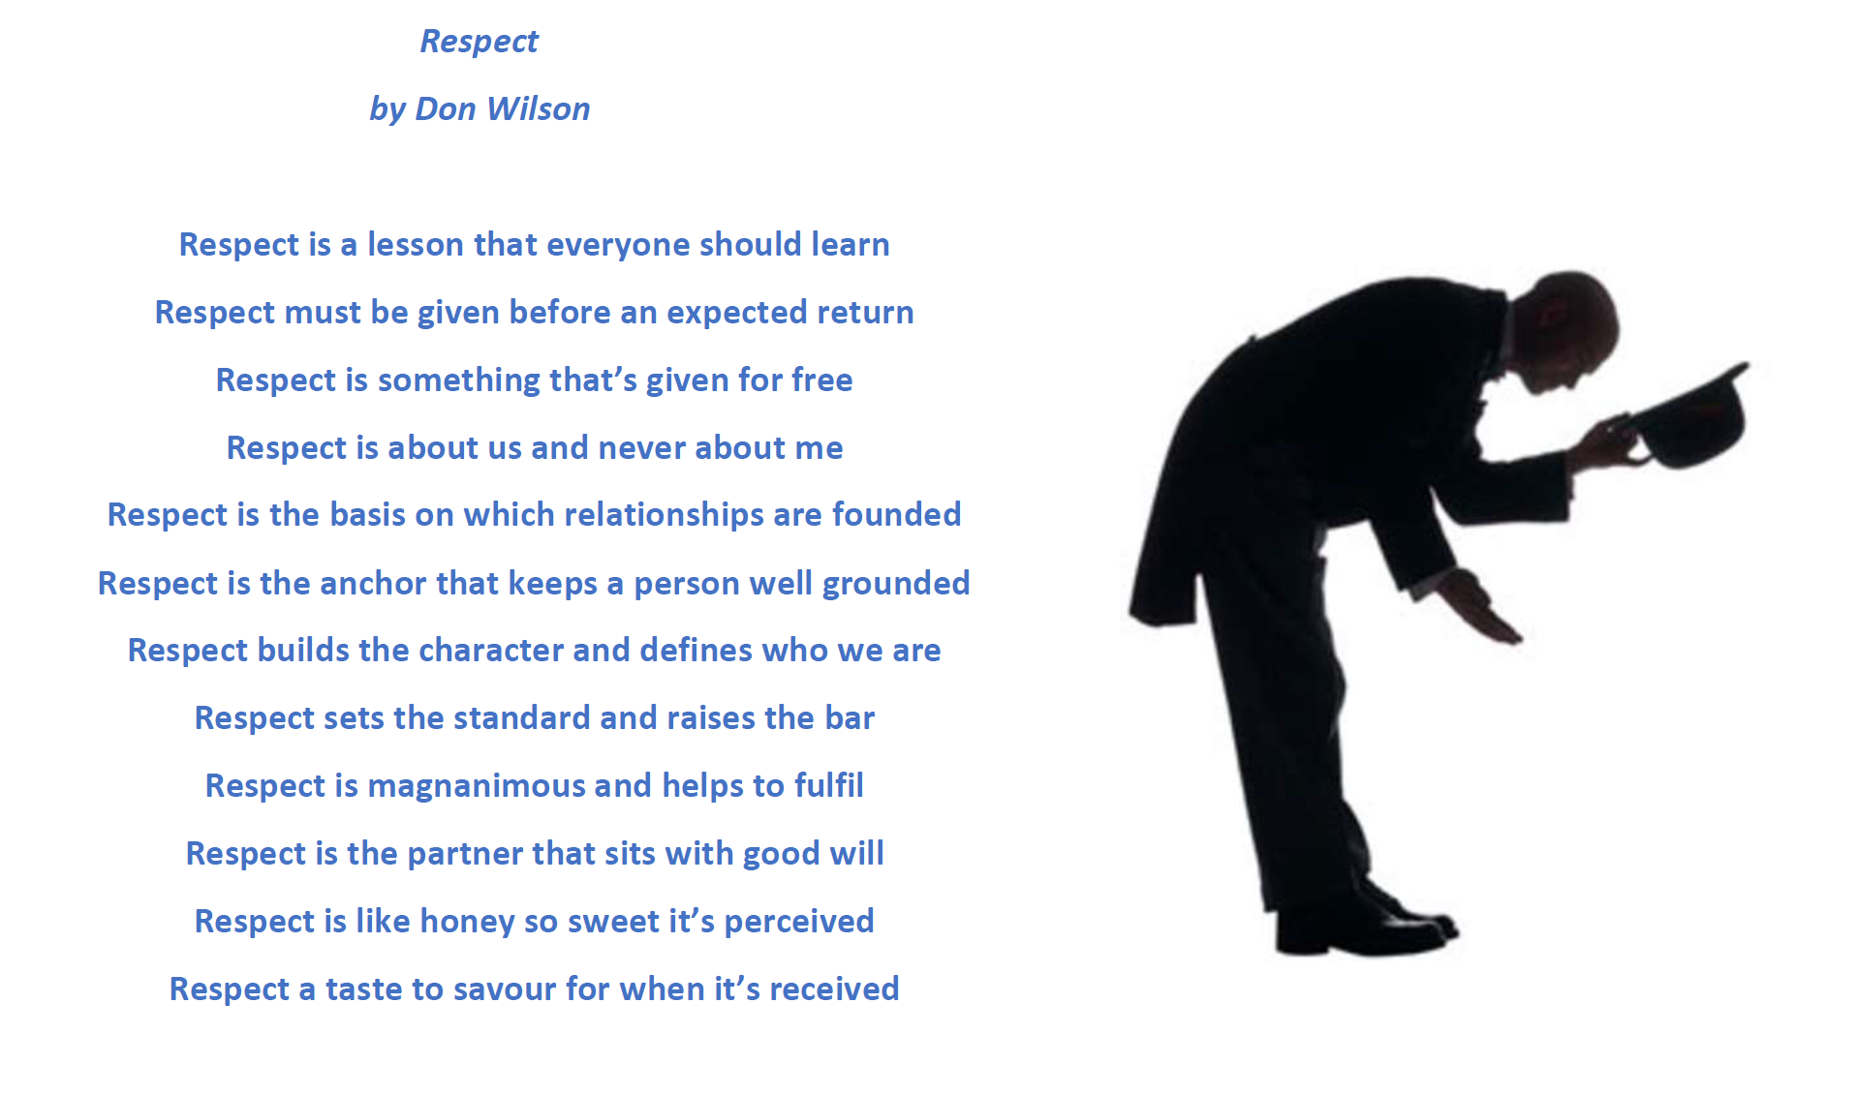

Slide 6
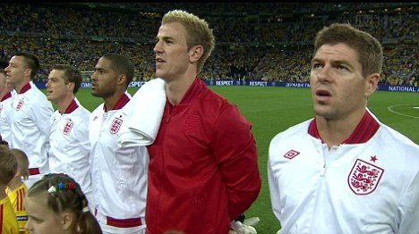
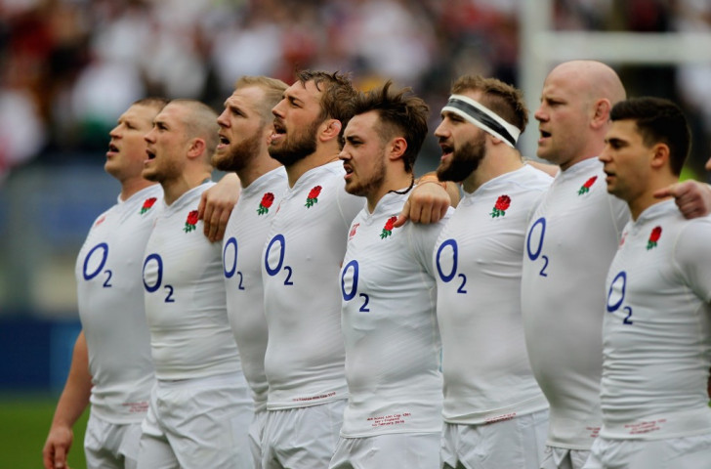
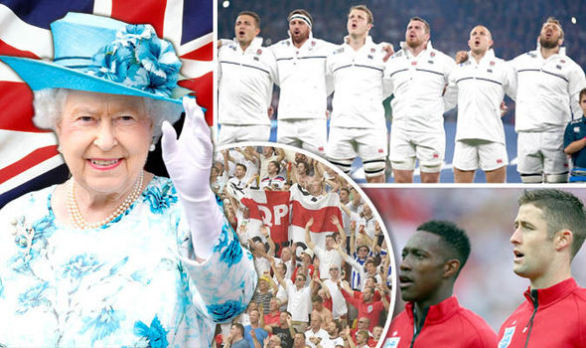
When the National Anthem is sung at a England sporting event – Everyone stands and sings as a sign of Respect.

Slide 7
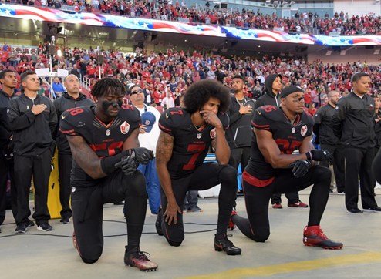
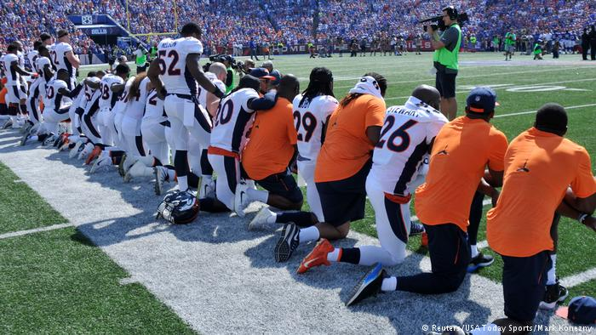
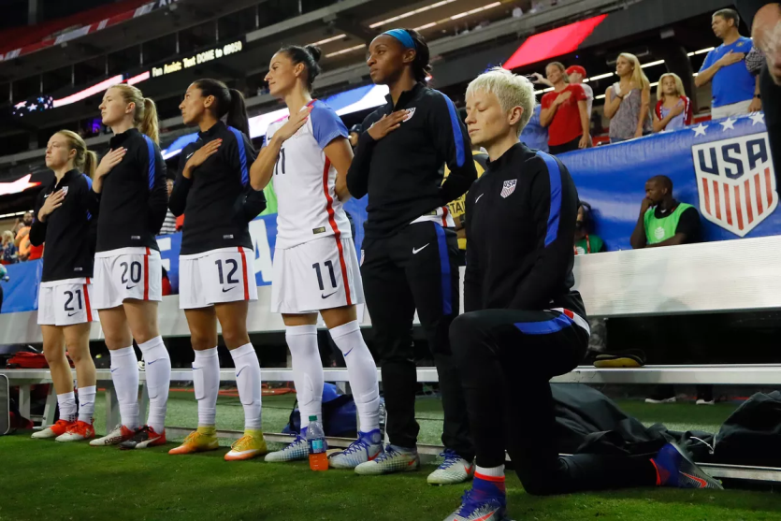
This week many American sports stars have been objecting against unfairness and police violence in America towards minority groups by kneeling during the National Anthem.
The American President, Donald Trump has said that the sports stars are being disrespectful but the players insist that respect is treating everyone equally which isn’t currently happening.

Slide 8
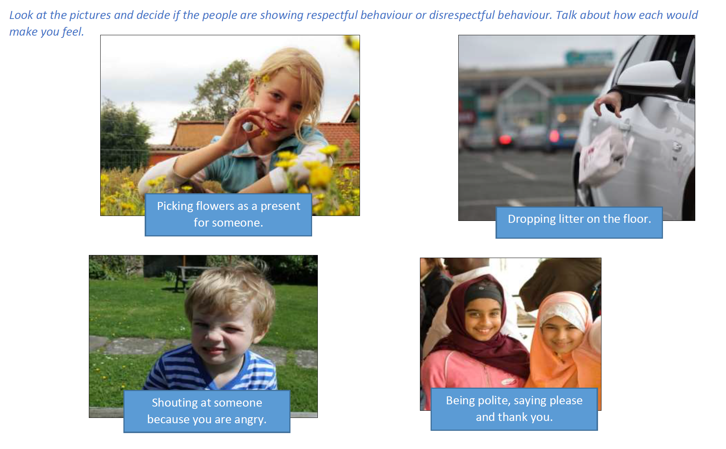

Slide 9
Prayer
Dear God,
Respect can be shown in lots of different ways.
Help us to remember that as long as we are considerate, kind and most importantly, treat everyone fairly we will be behaving in a respectful way.
Help us to build a world that is a better, kinder place to live. Amen

