Slide 1
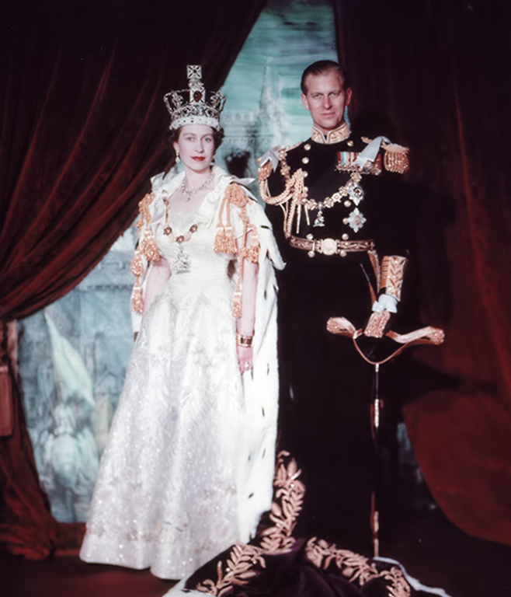
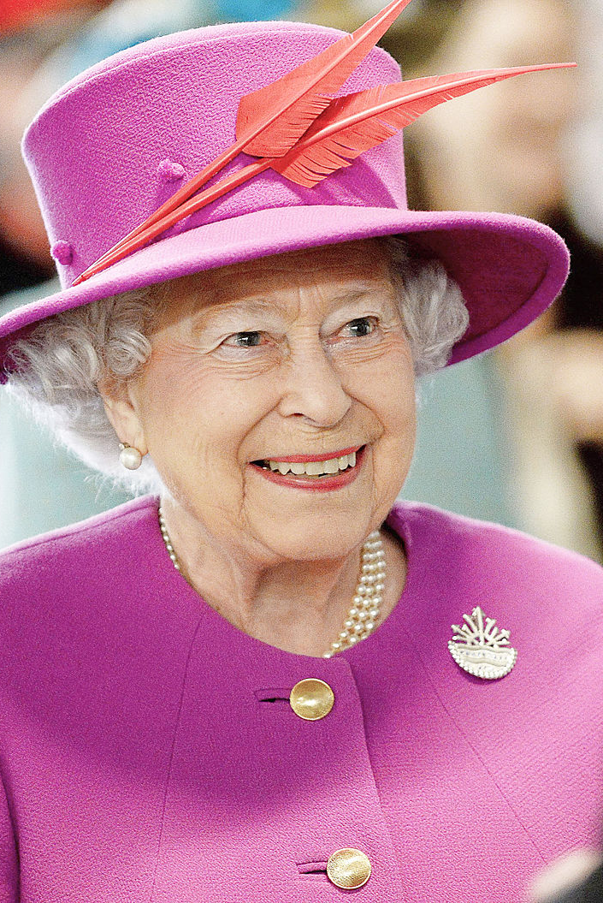
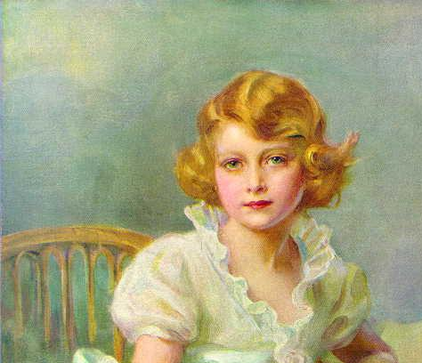
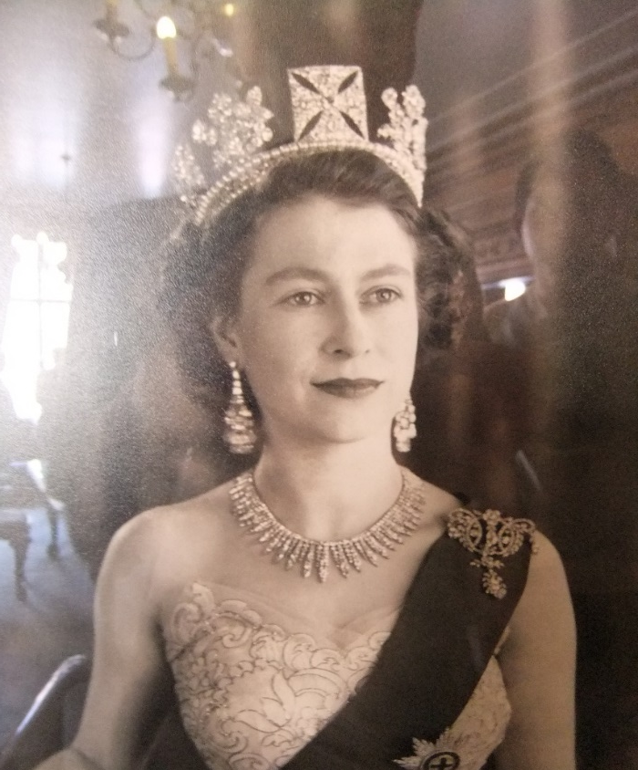
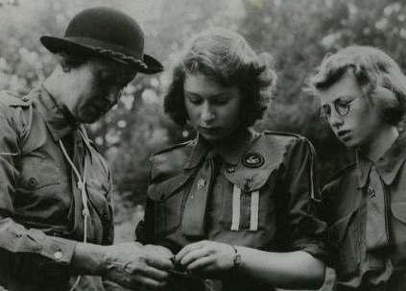
Queen Elizabeth II
Platinum Jubilee
Notes:
Queen in pink hat By Joel Rouse/ Ministry of Defence - https://www.defenceimagery.mod.uk/fotoweb/archives/5000-Current%20News/Archive%20(Navy)/RoyalNavy/2015/March/45158590.jpg, OGL 3, https://commons.wikimedia.org/w/index.php?curid=39183110

Slide 2
Yesterday, Queen Elizabeth II became the first British monarch to celebrate a Platinum Jubilee, seventy years of service. She became Queen on 6th February 1952 when she was 25 years old.

Slide 3
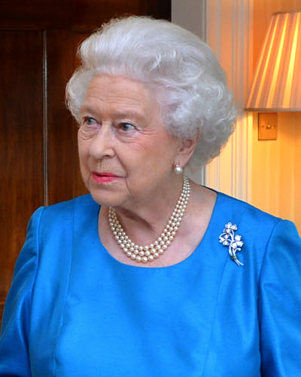
On 21st April, 2021 she celebrated her 95th birthday. She continues to carry out her royal duties.
Today we are looking at the life of our truly inspirational Queen.
Notes:
https://commons.wikimedia.org/wiki/File:Queen_Elizabeth_II_at_Hillsborough_Castle.jpg

Slide 4
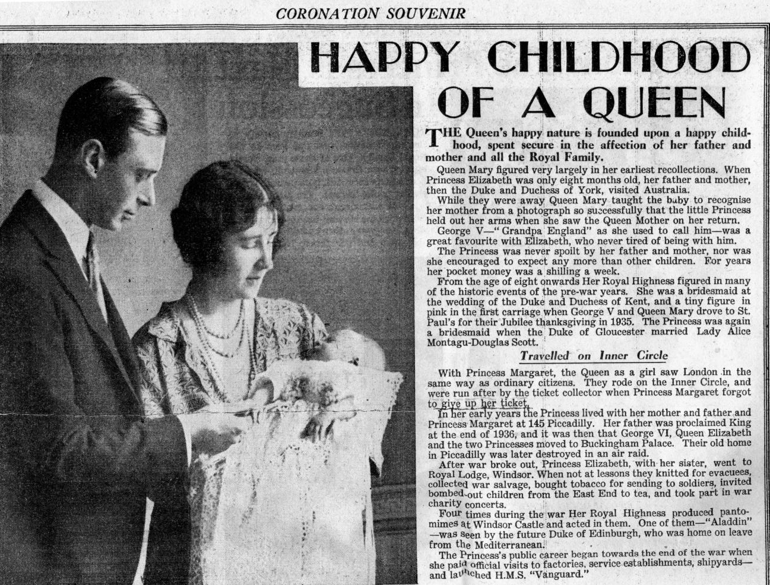
The Queen was born at 17, Bruton Street, Westminster, London on 21st April, 1926 and was named Princess Elizabeth Alexandra Mary Windsor.
Notes:
https://www.flickr.com/photos/karen_roe/6948748471/in/album-72157629136796578

Slide 5

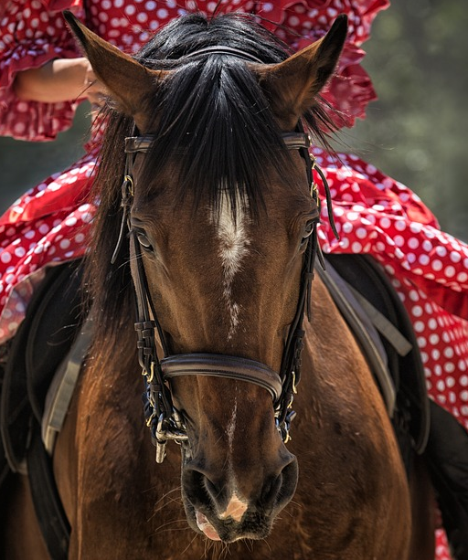

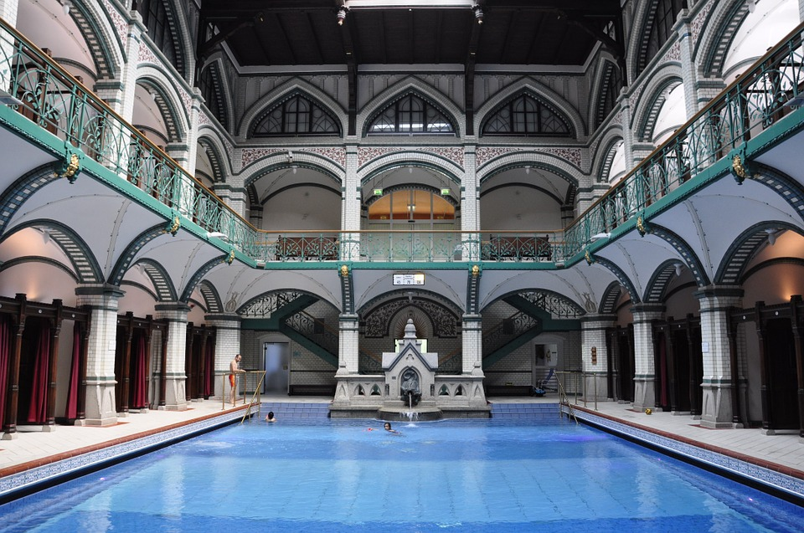
Princess Elizabeth studied art and music, learned to ride and to swim.

Slide 6
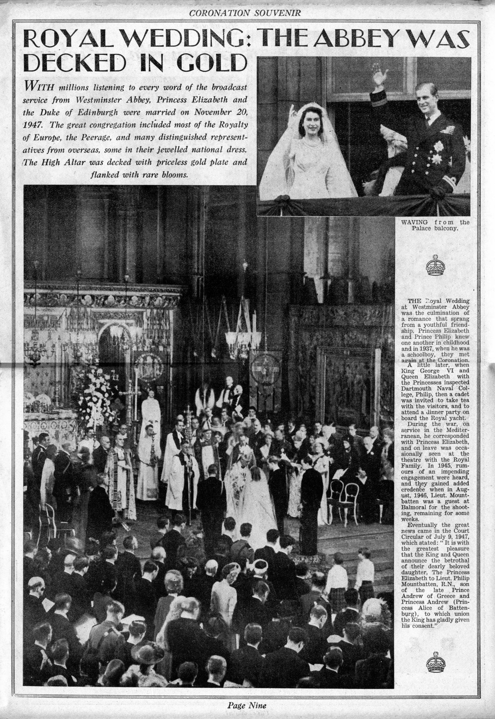
The Queen married Philip Mountbatten, The Duke of Edinburgh, on 20th November, 1947 at Westminster Abbey.
Notes:
https://www.flickr.com/photos/karen_roe/6970282982/in/album-72157629136796578/

Slide 7
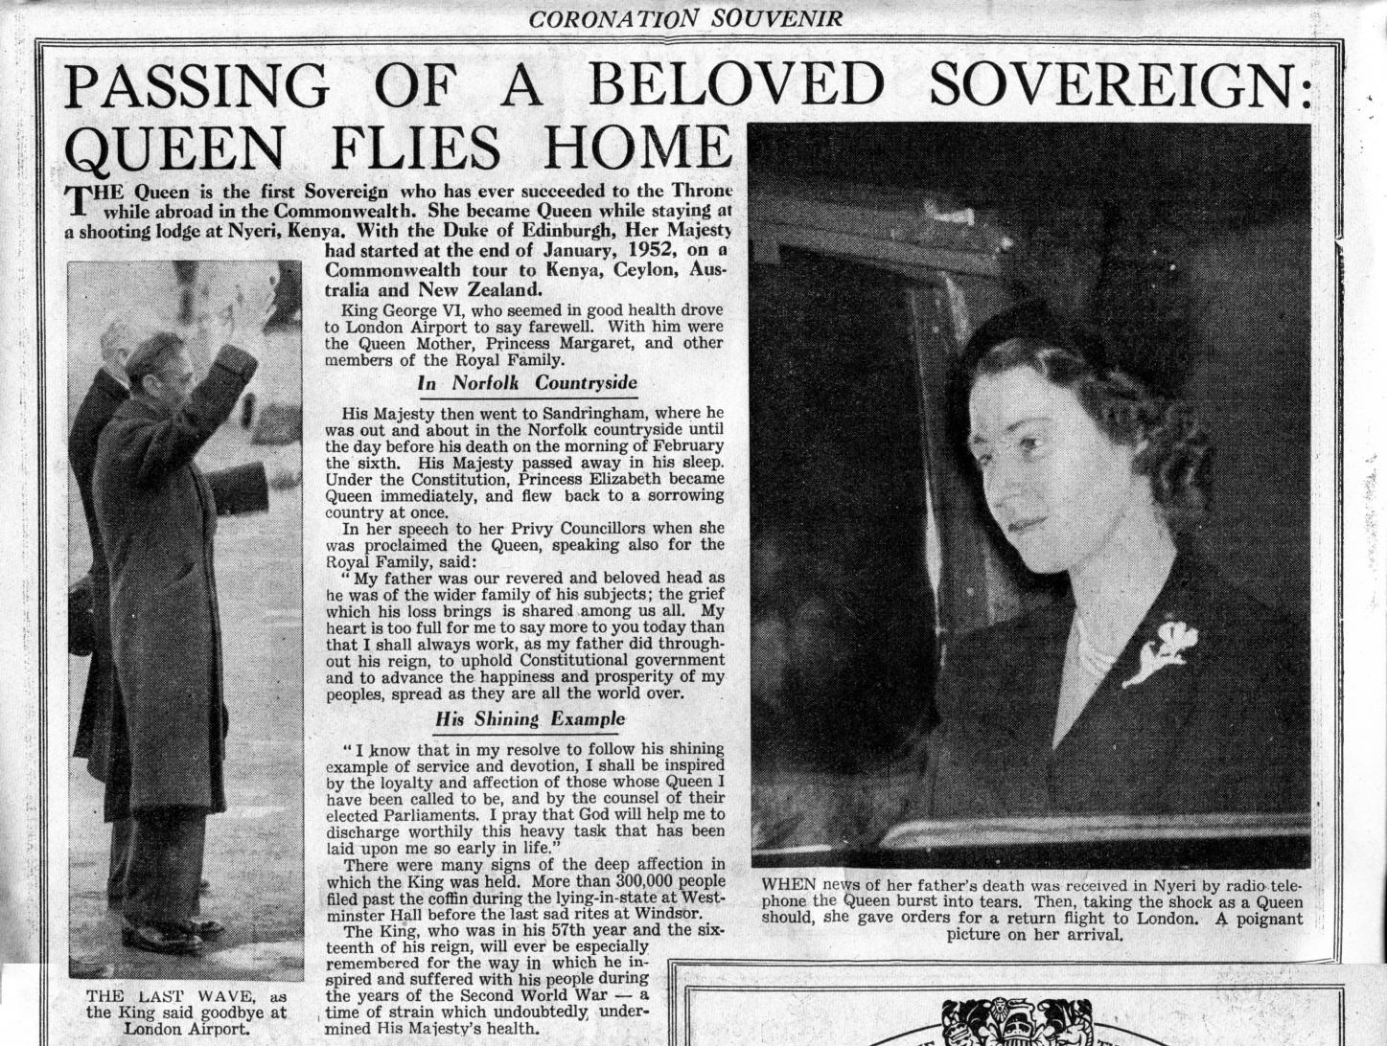
On 6th February, 1952 King George VI died. Princess Elizabeth and Prince Philip were in Kenya. Princess Elizabeth flew back to Britain as Queen Elizabeth II. She was just twenty-five years old when she became Queen.
Notes:
https://www.flickr.com/photos/karen_roe/6948748217/in/album-72157629136796578/

Slide 8
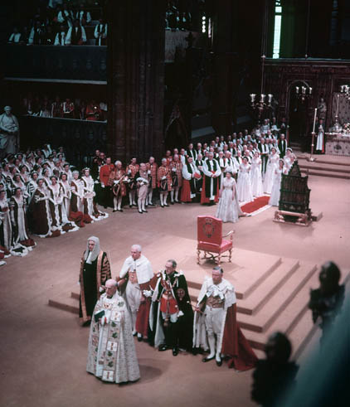
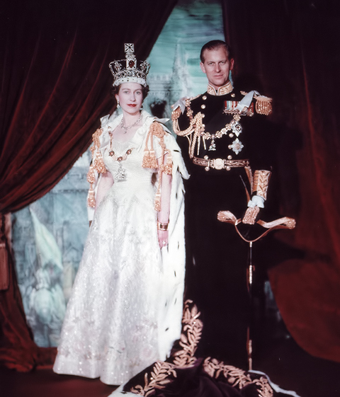
Queen Elizabeth’s Coronation Day took place on 2nd June, 1953.
Notes:
By BiblioArchives / LibraryArchives from Canada - Coronation of Queen Elizabeth II / uronnement de la Reine Elizabeth IIUploaded by oaktree_b, CC BY 2.0, https://commons.wikimedia.org/w/index.php?curid=19783528

Slide 9
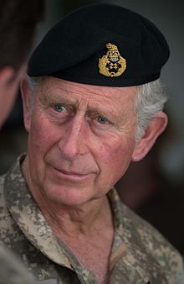
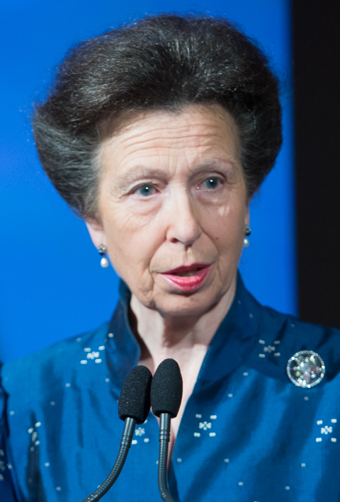
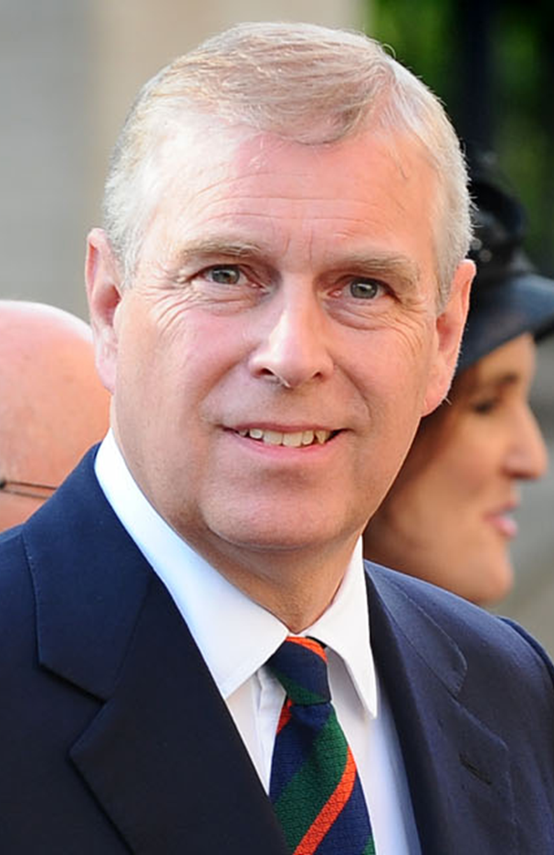
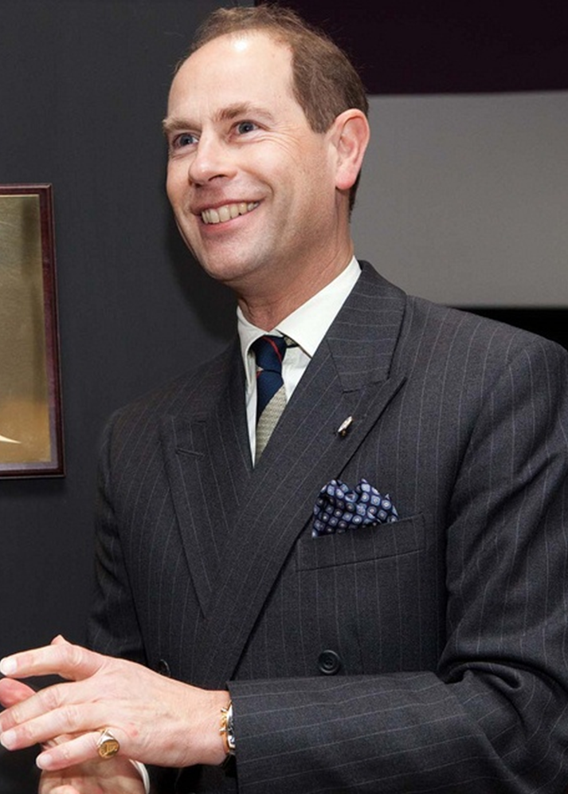
Here are the Queen’s children in later life.
Prince Charles
Princess Anne
Prince Andrew
Prince Edward
Notes:
By Library and Archives Canada, e010949328 / Bibliothèque et Archives Canada, e010949328 - http://www.flickr.com/photos/lac-bac/7195940876/, CC BY 2.0, https://commons.wikimedia.org/w/index.php?curid=27933715

Slide 10
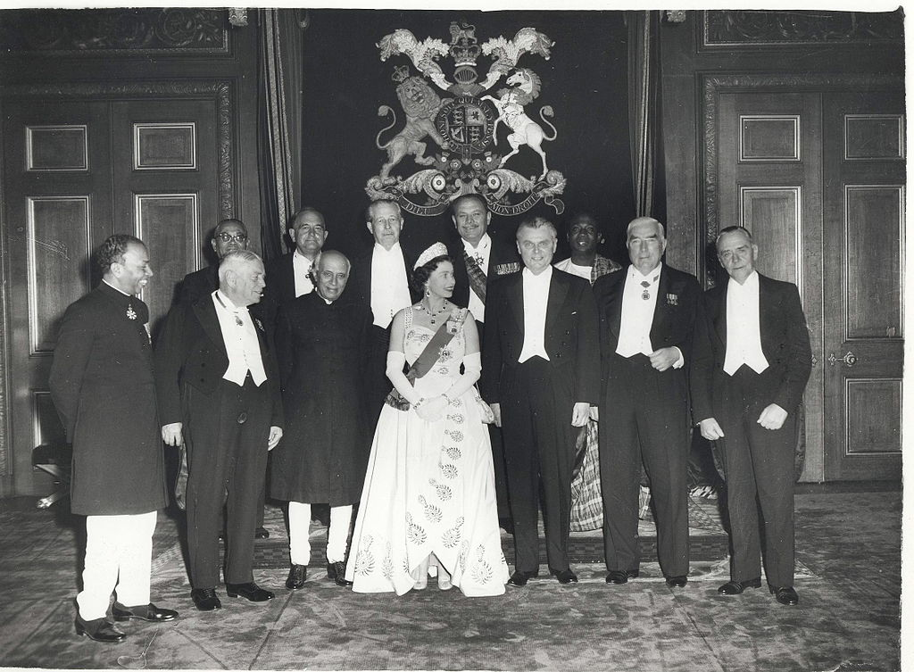
The Queen is the Head of State of the United Kingdom, Head of the Church of England and………

Slide 11
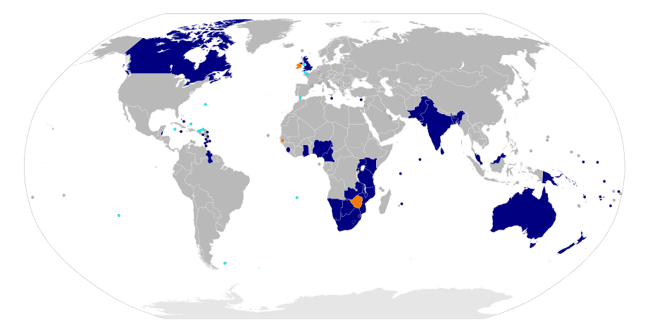
The Queen has reigned over many countries. She is also the Queen of Canada, Australia, New Zealand, Jamaica, Barbados and ten other independent countries as well as the Head of the Commonwealth.
Commonwealth of Nations members
Former Commonwealth of Nations members (Ireland, The Gambia, and Zimbabwe
British Overseas Territories and Crown dependencies
Notes:
https://en.wikipedia.org/wiki/Member_states_of_the_Commonwealth_of_Nations

Slide 12
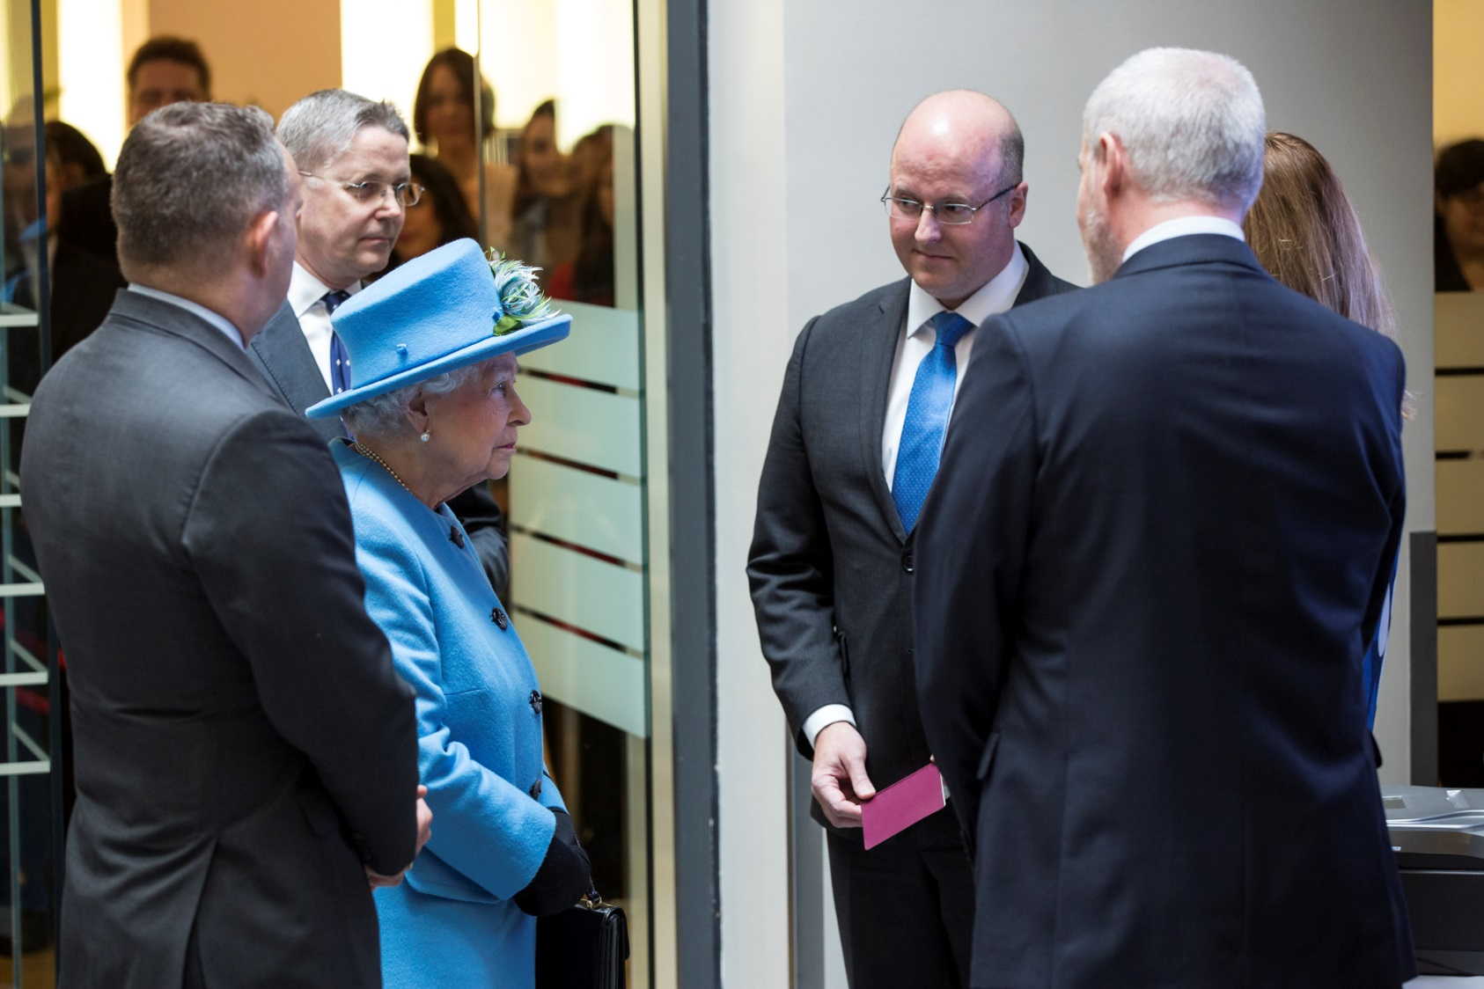
The Queen spends some mornings on visits. Sometimes, she visits up to three places before lunch.
Notes:
https://www.flickr.com/photos/ukhomeoffice/22751070847

Slide 13
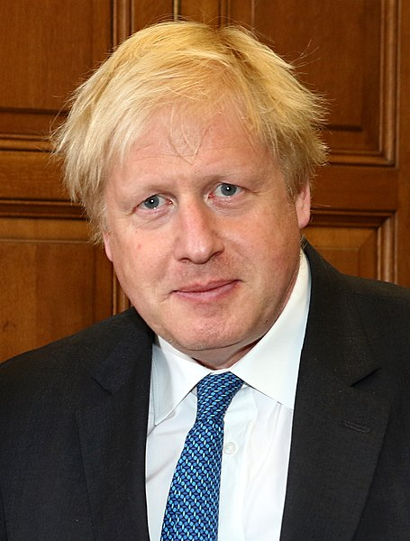
And every week the Queen meets with the Prime Minister when they are both in London.
Notes:
https://commons.wikimedia.org/wiki/File:Yukiya_Amano_with_Boris_Johnson_in_London_-_2018_(41099455635)_(cropped).jpg

Slide 14
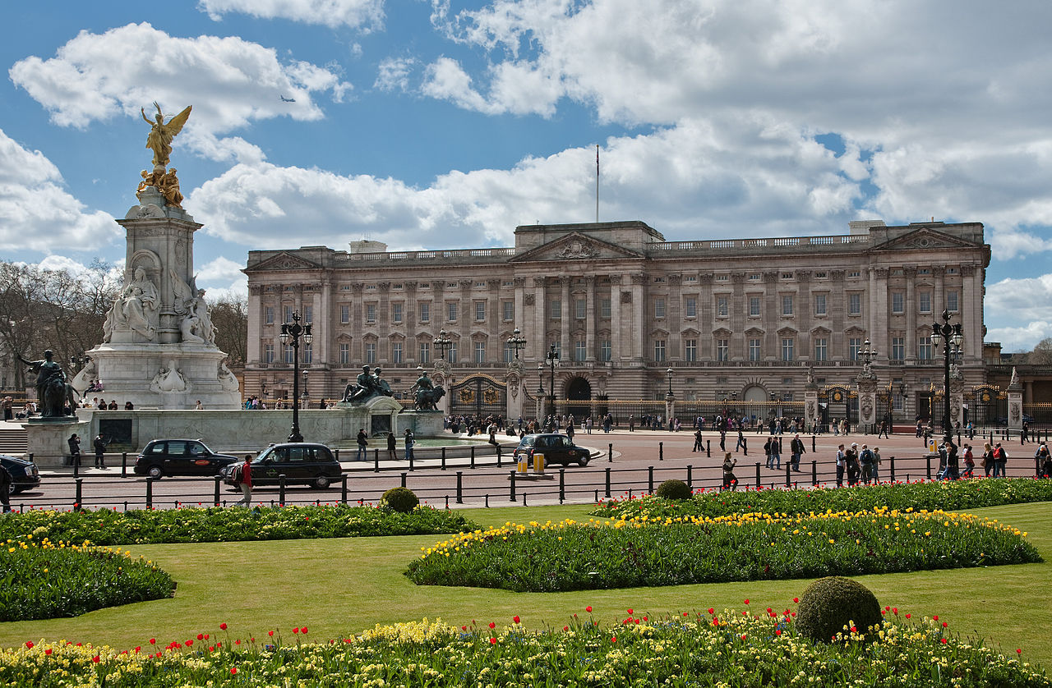
The Queen has many homes. Most of the time she lives in Buckingham Palace in London.
Notes:
By Diliff - Own work, CC BY-SA 3.0, https://commons.wikimedia.org/w/index.php?curid=6488843

Slide 15
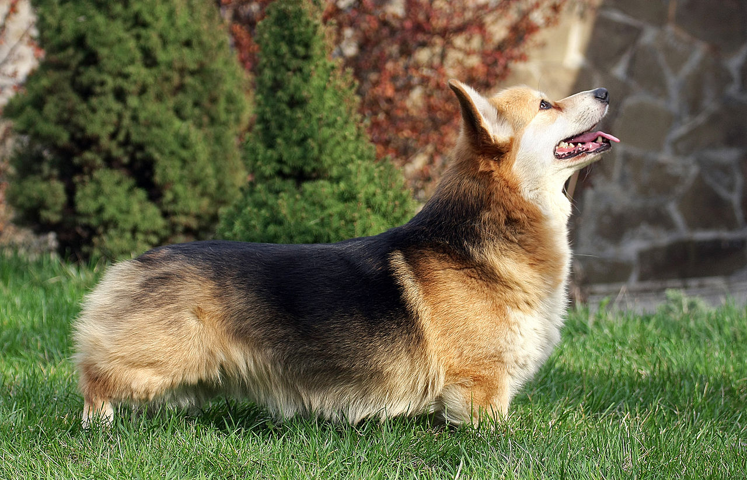
The Queen loves dogs. Her favourite breed is the Pembroke Welsh Corgi. She has owned more than thirty corgis during her reign.
Notes:
CC BY-SA 3.0
https://en.wikipedia.org/wiki/Pembroke_Welsh_Corgi#/media/File:Pembroke_Welsh_Corgi.jpg

Slide 16
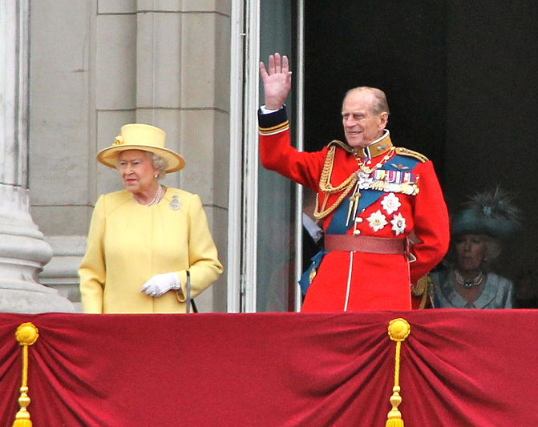
Prince Philip was the longest-serving consort of a reigning British monarch and also the longest-lived male descendant of the Royal family.
Notes:
By Peter Ellis - Own work, CC BY-SA 3.0, https://commons.wikimedia.org/w/index.php?curid=17080581

Slide 17
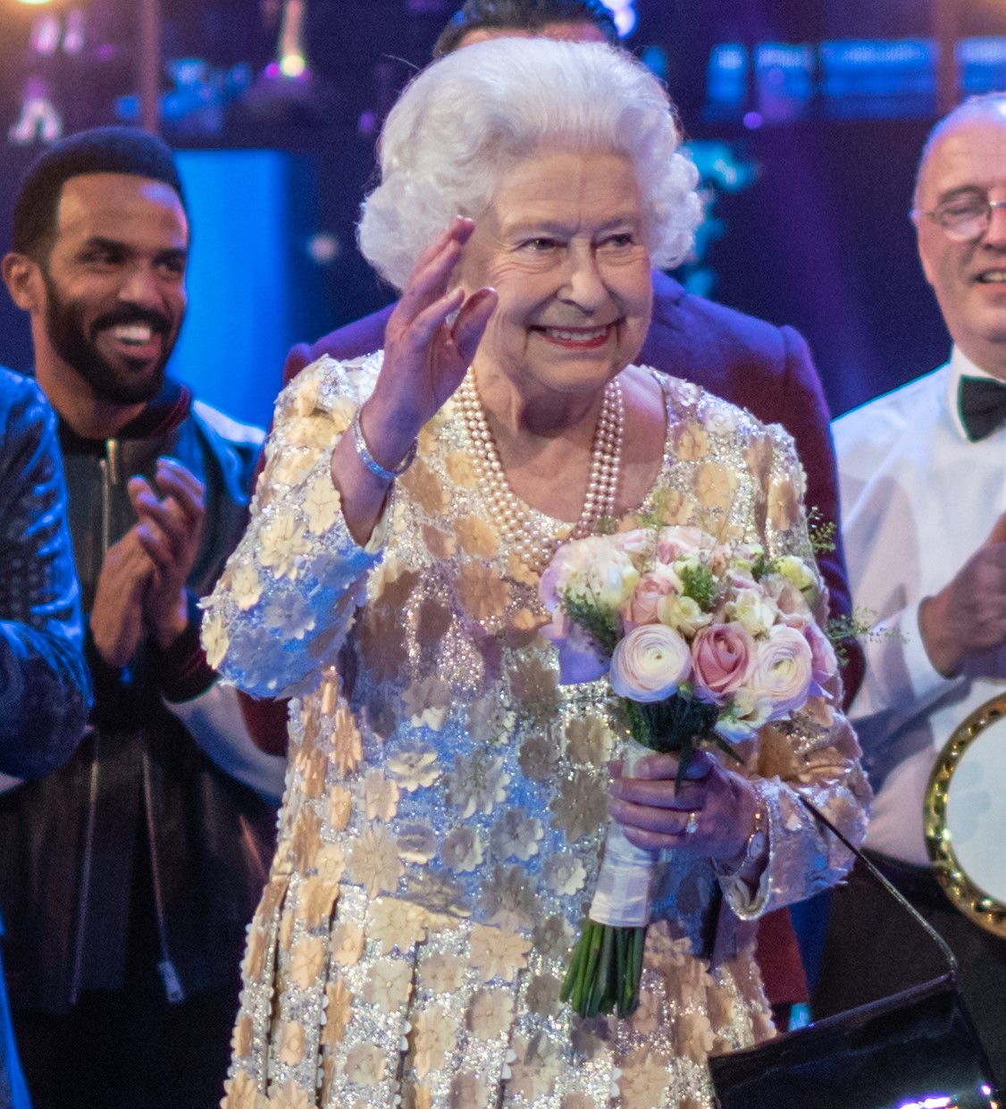
On 6th February 2022 the Queen celebrated her Platinum Jubilee which marks seventy years of service.
Notes:
https://upload.wikimedia.org/wikipedia/commons/a/a5/Elizabeth_II_birthday_2018.jpg

Slide 18
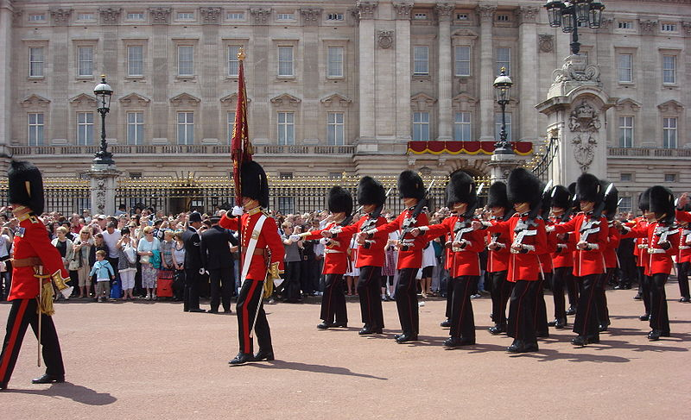
On Thursday 2nd June, the Queen’s birthday parade, Trooping the Colour, will take place involving over 1,400 soldiers, 200 horses and 400 musicians.
Notes:
https://commons.wikimedia.org/wiki/File:Trooping_the_Colour_2009_093.jpg

Slide 19
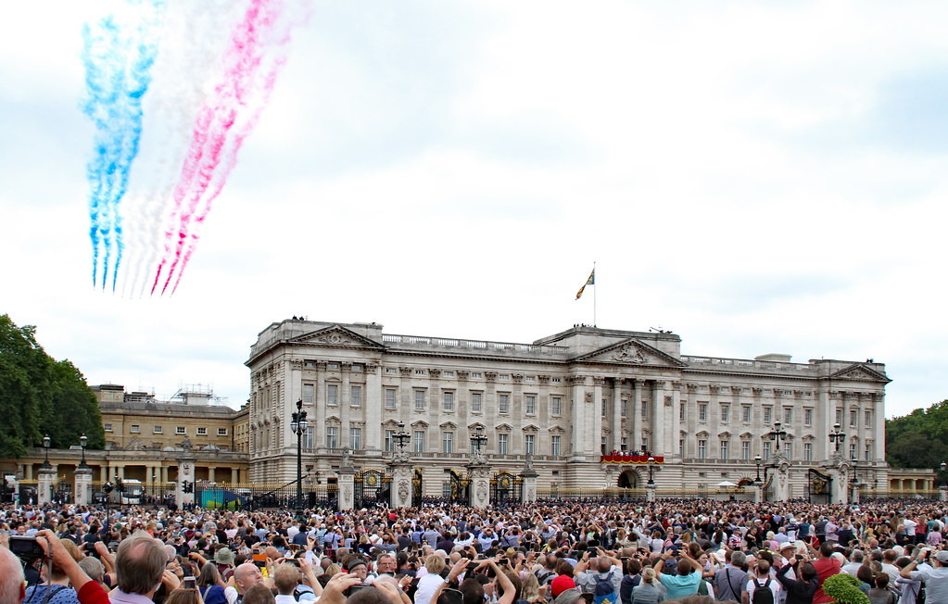
The Parade will end with the traditional RAF fly-past, watched by the Queen and royal family from the Buckingham Palace balcony.
Notes:
https://www.flickr.com/photos/hisgett/28469645417

Slide 20
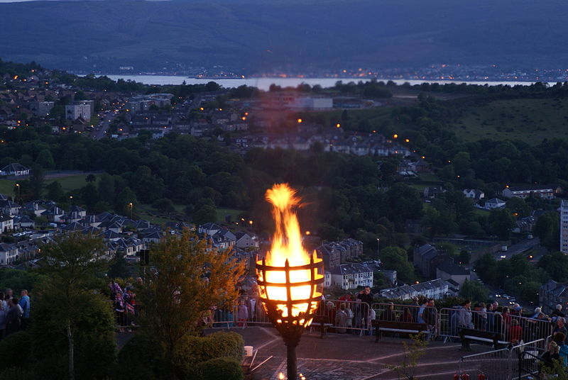
Beacons will be lit throughout the United Kingdom, Channel Islands, Isle of Man and each of the capital cities of the Commonwealth countries.
Notes:
https://commons.wikimedia.org/wiki/File:Lyle_Hill,_Diamond_Jubilee,_Beacon.JPG

Slide 21
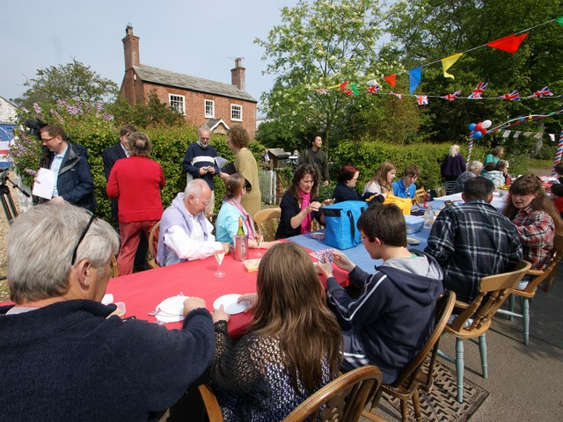
On Sunday 5th June there will be ‘The Big Jubilee Lunch’. Since it began in 2009, the Big Lunch has encouraged communities to get to know each other better. As part of the Jubilee celebrations communities will be encouraged to share friendship, food and fun with neighbours.
Notes:
https://www.geograph.org.uk/photo/2451927

Slide 22
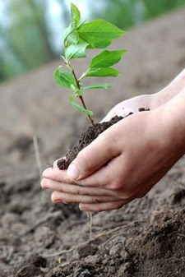
To mark The Queens’ Platinum Jubilee in 2022, everyone across the UK is being invited to plant a tree from October 2021, when the tree planting season begins, through to the end of the Jubilee year in 2022. It has been called the ‘Queen’s Green Canopy’ initiative. The Queen joined The Prince of Wales, patron of the Queen's Green Canopy, for the first Jubilee tree planting at Windsor Castle on 17th May, 2021.
Notes:
https://commons.wikimedia.org/wiki/File:Plant_tree.png

Slide 23
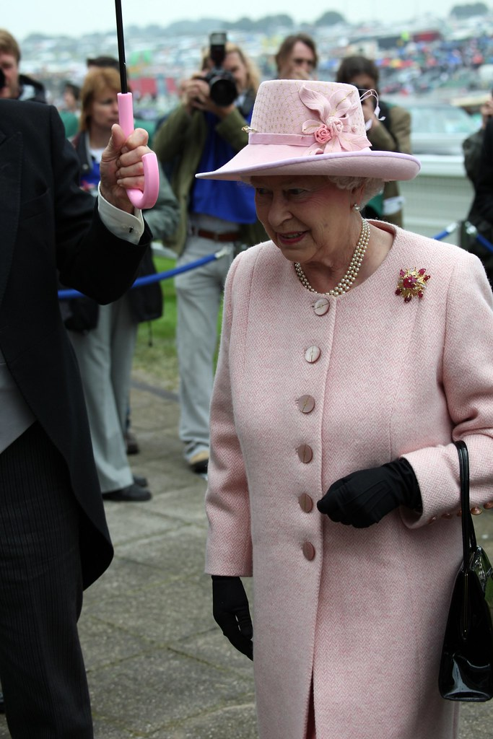
There can be no doubt that Queen Elizabeth is a truly inspirational person.
Notes:
https://www.flickr.com/photos/ndecam/3661182772

